Slide 2
Reinforcement Learning
Lecture 4 – Introduction to Policy Gradient Methods

Slide 3
Course Agenda
Lecture 1
Introduction to Reinforcement Learning
Finite Markov Decision Process
Bellman Equations
Dynamic Programming
Lecture 2
Monte Carlo Methods
Temporal-Difference Learning
SARSA and Q-Learning
Lecture 3
On Policy Prediction and Control with Approximation
Off Policy Methods with Approximation
Lecture 4
Policy Gradient Methods
Lecture 5
Multi-armed Bandits

Slide 4
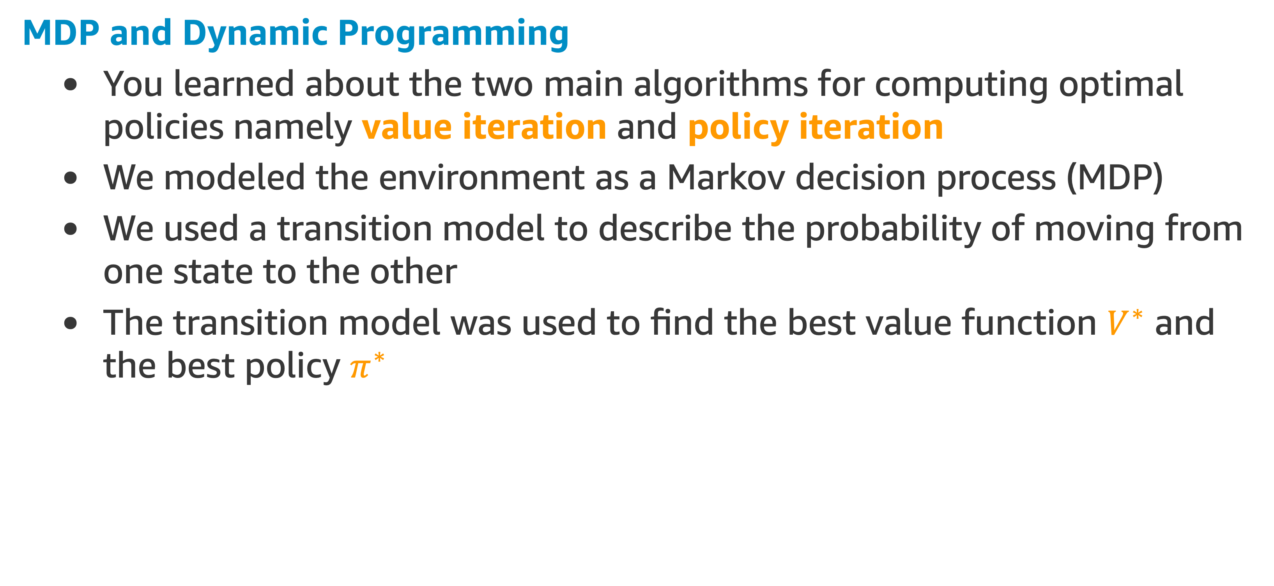
Recap Lecture 1
MDP and Dynamic Programming
You learned about the two main algorithms for computing optimal policies namely value iteration and policy iteration
We modeled the environment as a Markov decision process (MDP)
We used a transition model to describe the probability of moving from one state to the other
The transition model was used to find the best value function $V^{∗}$ and the best policy $π^{∗}$

Slide 5
Recap Lecture 2
Monte Carlo methods
Ways of solving the reinforcement learning problem based on averaging sample returns
Sample sequences of states, actions, and rewards from actual or simulated interaction with an environment
Episodic updates
Temporal-Difference (TD)
Similar to Monte-Carlo methods, Temporal-Difference (TD) Learning is model-free and learns from episodes of experience
However, TD learning can learn from incomplete episodes and hence we don’t need to track the episode up to termination

Slide 6
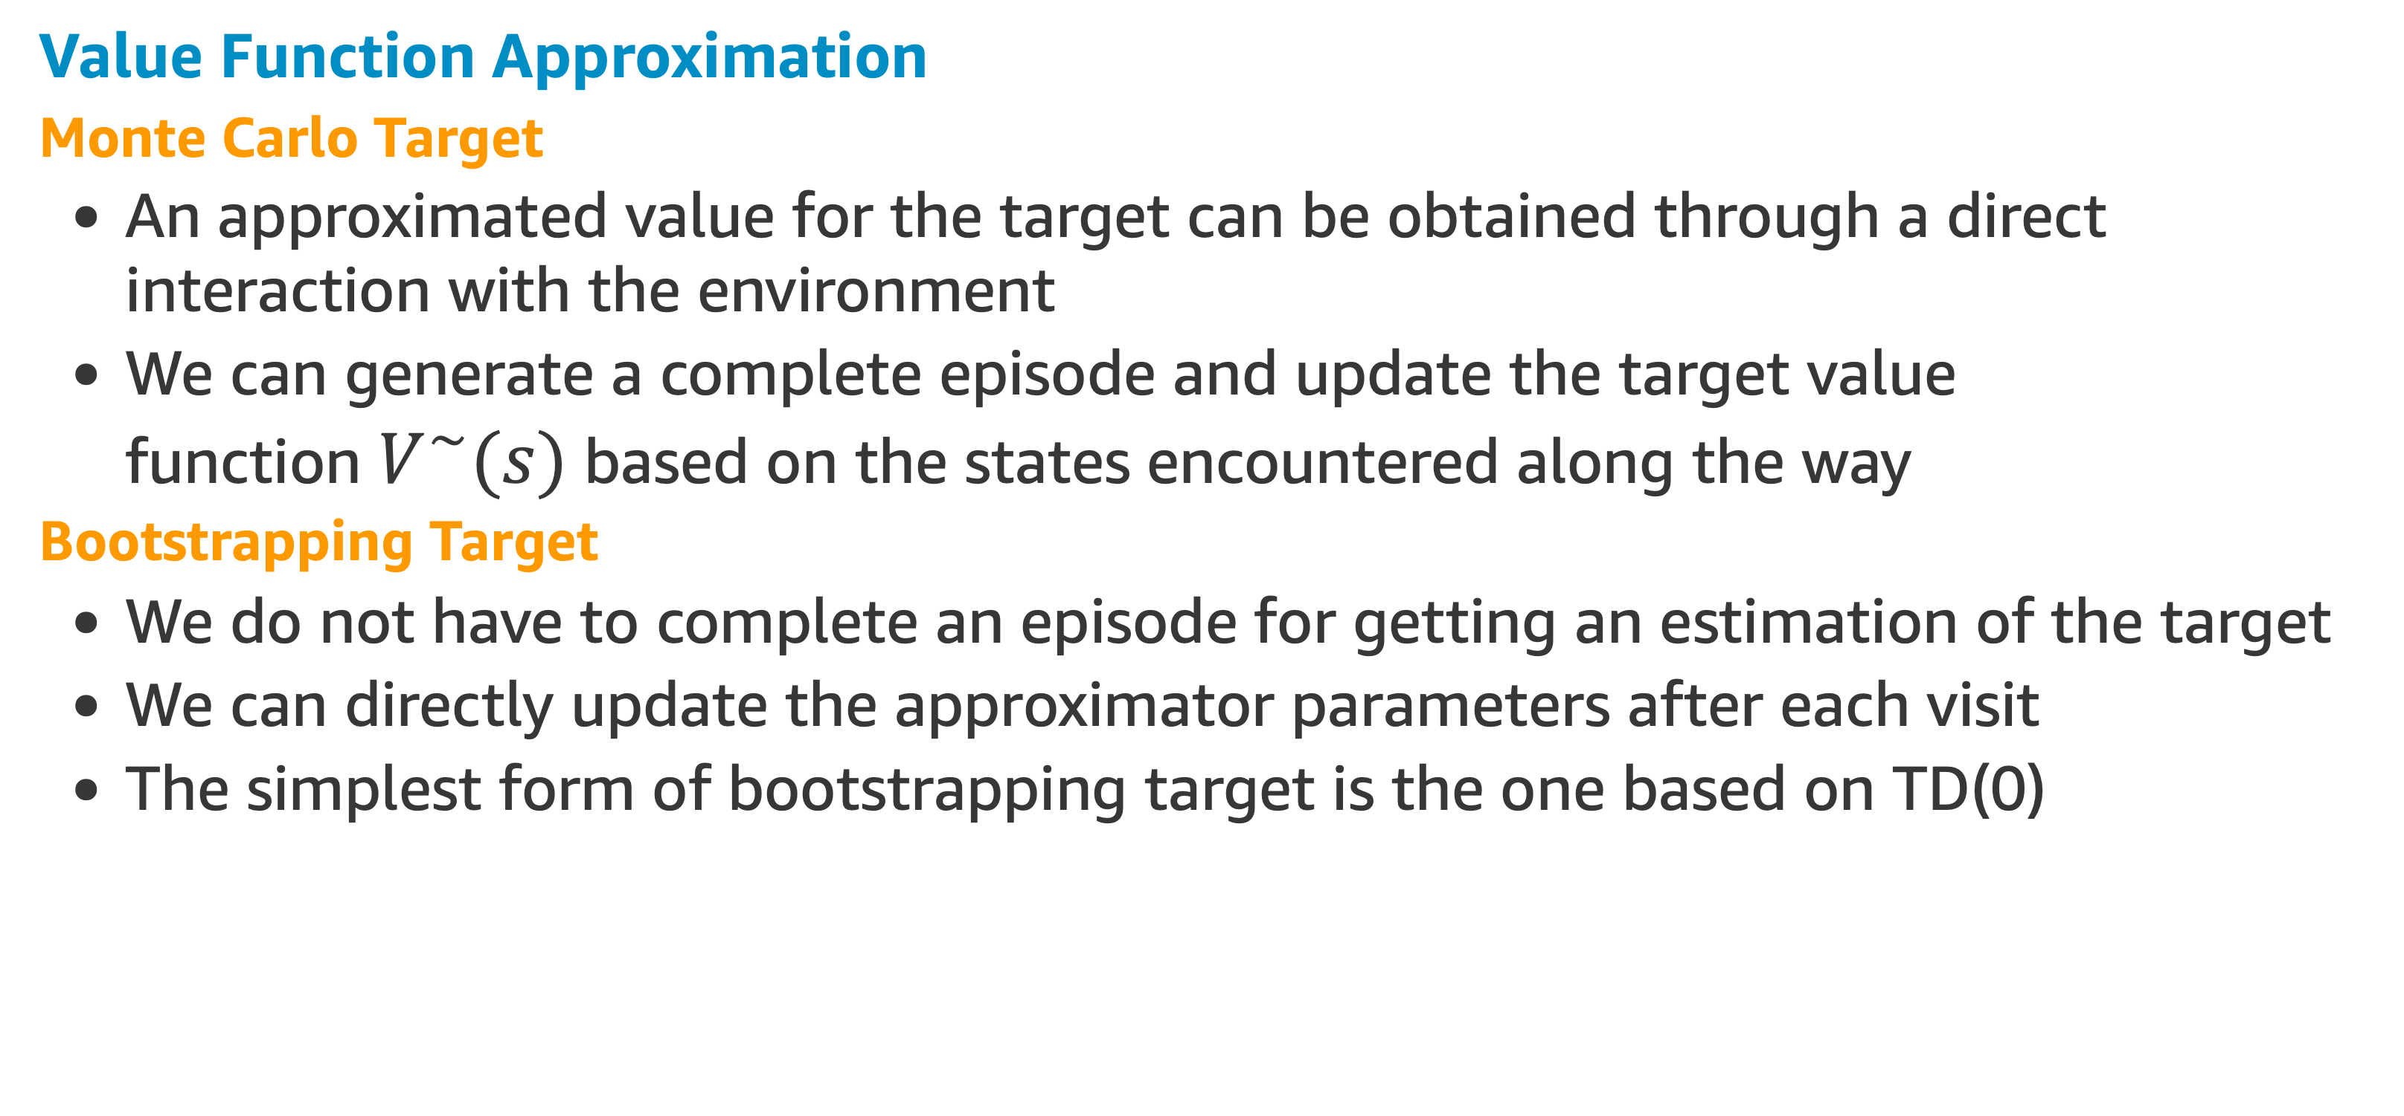
Recap Lecture 3
Value Function Approximation
Monte Carlo Target
An approximated value for the target can be obtained through a direct interaction with the environment
We can generate a complete episode and update the target value function $V^{∼}(s)$ based on the states encountered along the way
Bootstrapping Target
We do not have to complete an episode for getting an estimation of the target
We can directly update the approximator parameters after each visit
The simplest form of bootstrapping target is the one based on TD(0)
NEXT TOPIC: Policy Gradient methods

Slide 7
Policy Gradient Methods

Slide 8
Policy Gradient Methods
So far, almost all the methods used have been action-value methods.
They learned the values of actions and then selected actions based on their estimated action values.
Now we consider methods that, instead, will learn a parameterized policy that can select actions without consulting a value function
A value function may still be used to learn the policy parameter, but is not required for action selection.

Slide 9
Policy Gradient Methods
Problems vary in the complexity of their policies and action-value functions
For some, the action-value function is simpler and thus easier to approximate.
For others, the policy is simpler.
The choice of policy parameterization is sometimes a good way of injecting prior knowledge about the desired form of the policy into the reinforcement learning system
This is often the most important reason for using a policy-based learning method.

Slide 10
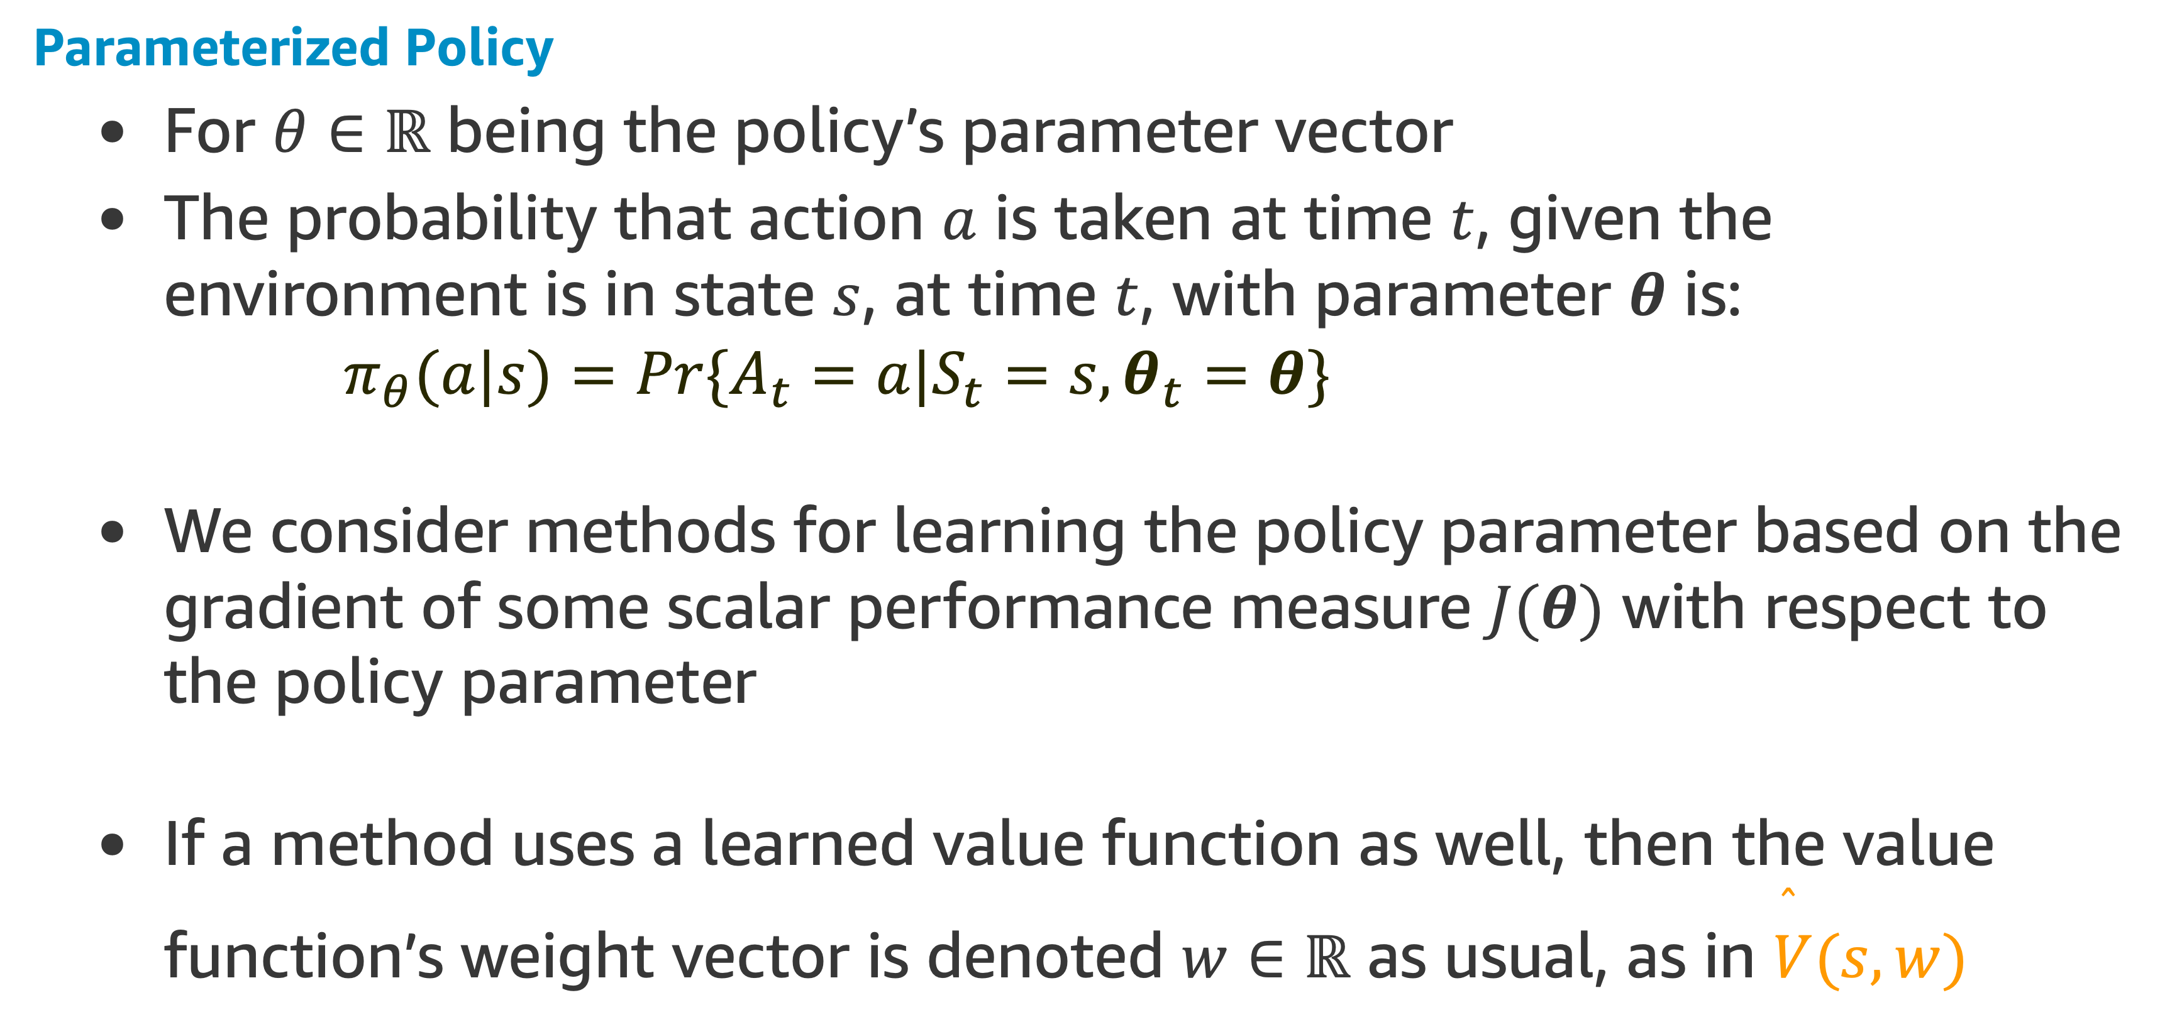
Policy Gradient Methods
Parameterized Policy
For $θ∈ℝ$ being the policy’s parameter vector
The probability that action $a$ is taken at time $t$, given the environment is in state $s$, at time $t$, with parameter $θ$ is:
$$π_{θ}(a|s)=Pr\{A_{t}=a|S_{t}=s,θ_{t}=θ\}$$
We consider methods for learning the policy parameter based on the gradient of some scalar performance measure $J(θ)$ with respect to the policy parameter
If a method uses a learned value function as well, then the value function’s weight vector is denoted $w∈ℝ$ as usual, as in $\overset{̂}{V}(s,w)$

Slide 11
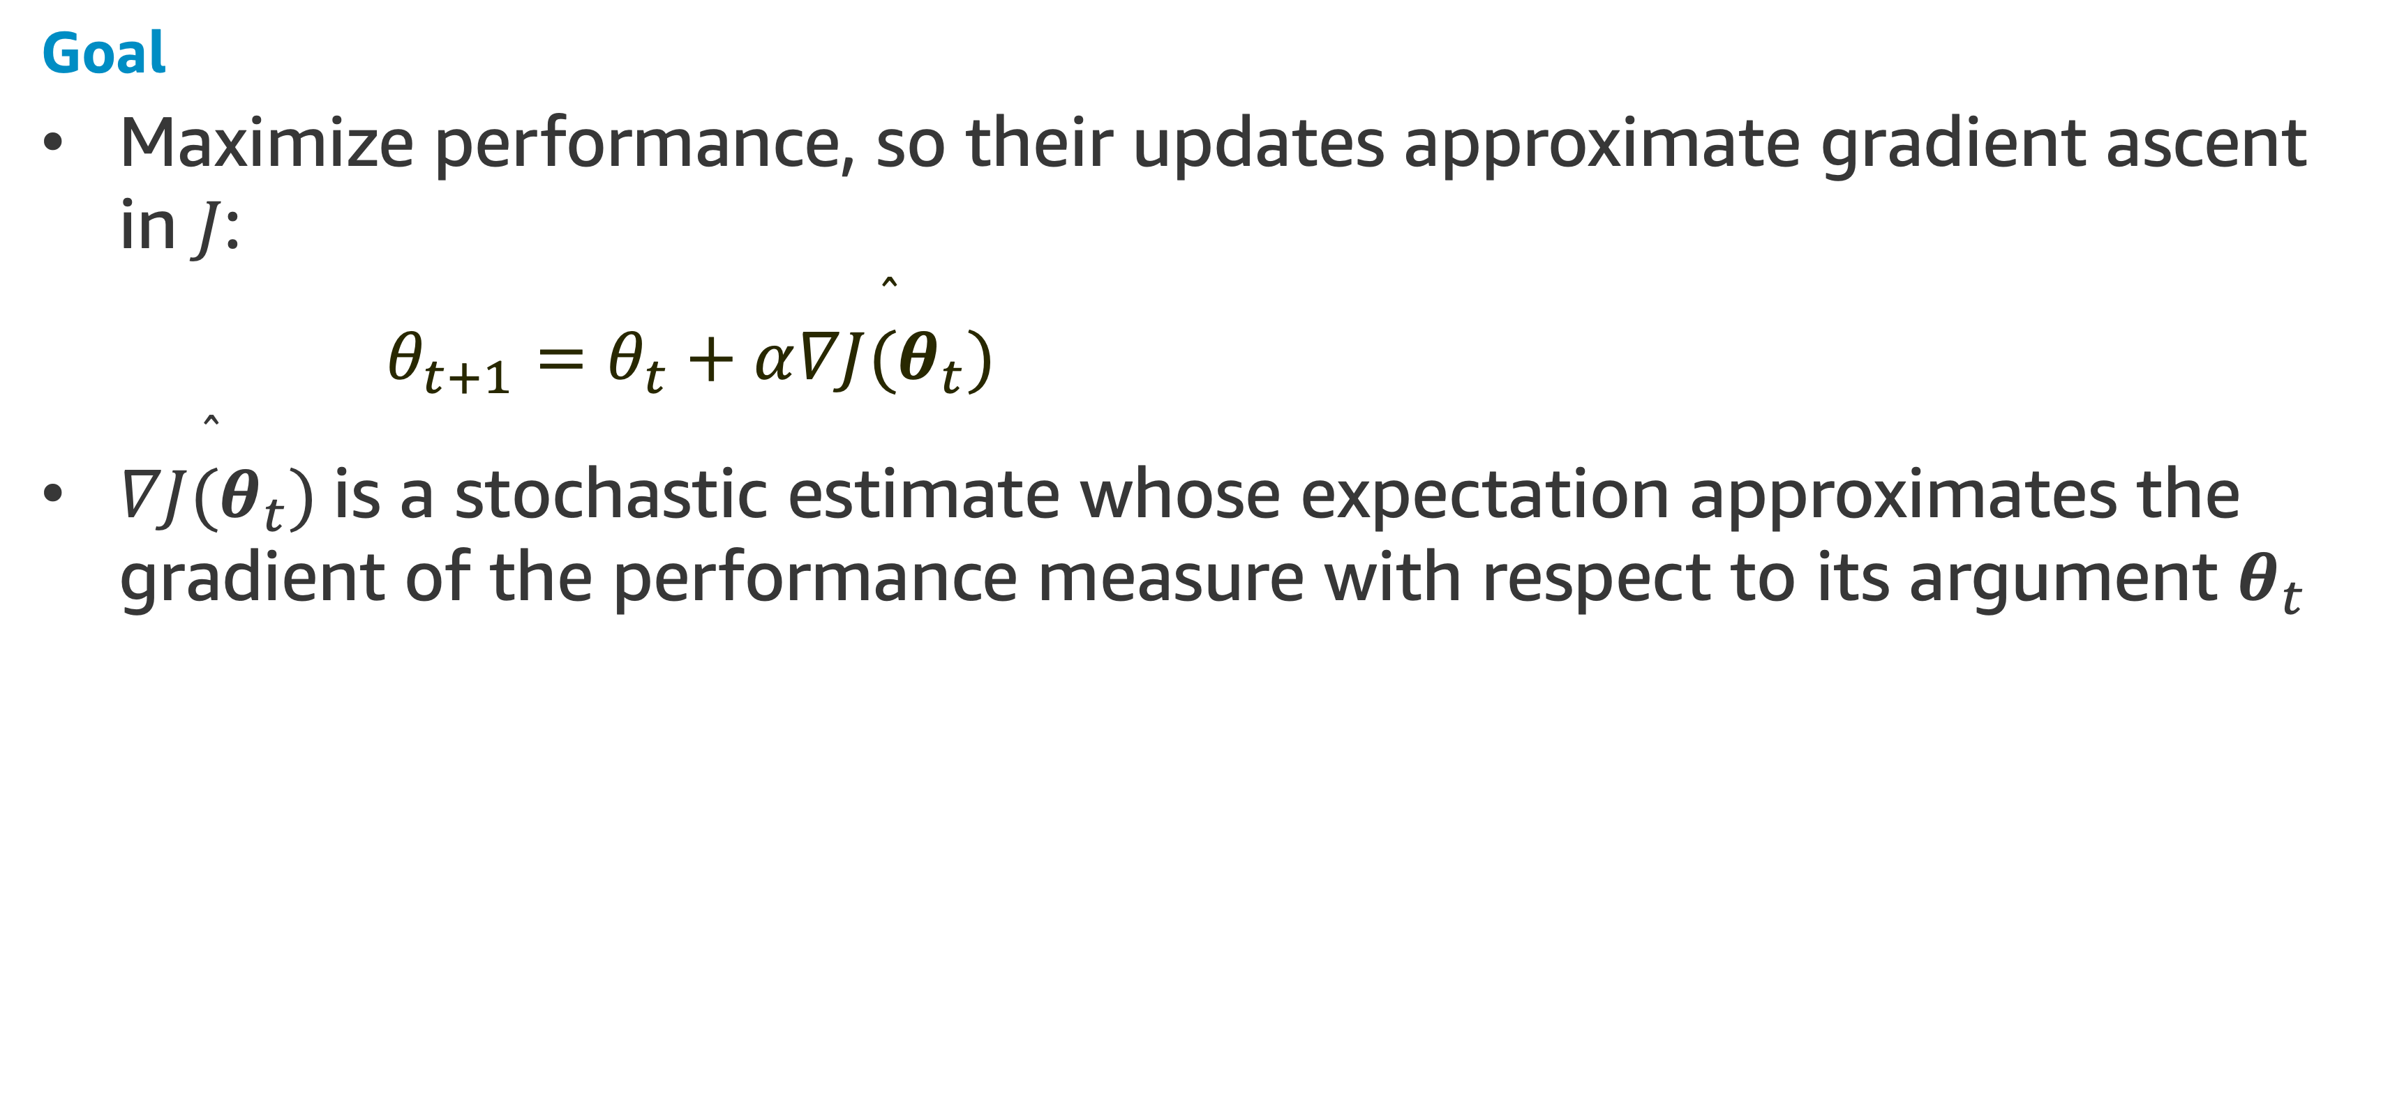
Policy Gradient Methods
Goal
Maximize performance, so their updates approximate gradient ascent in $J$:
$$θ_{t+1}=θ_{t}+α\overset{̂}{∇J(θ_{t})}$$
$\overset{̂}{∇J(θ_{t})}$ is a stochastic estimate whose expectation approximates the gradient of the performance measure with respect to its argument $θ_{t}$

Slide 12
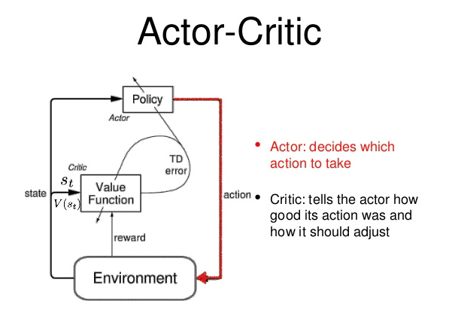
Policy Gradient Methods
Actor Critic Methods
All methods that follow this general schema we call policy gradient methods, whether or not they also learn an approximate value function
If the method learn approximations to both policy and value functions, they are often called actor–critic methods, where:
'actor' is a reference to the learned policy,
‘critic' refers to the learned value function, usually a state-value function.

Slide 13
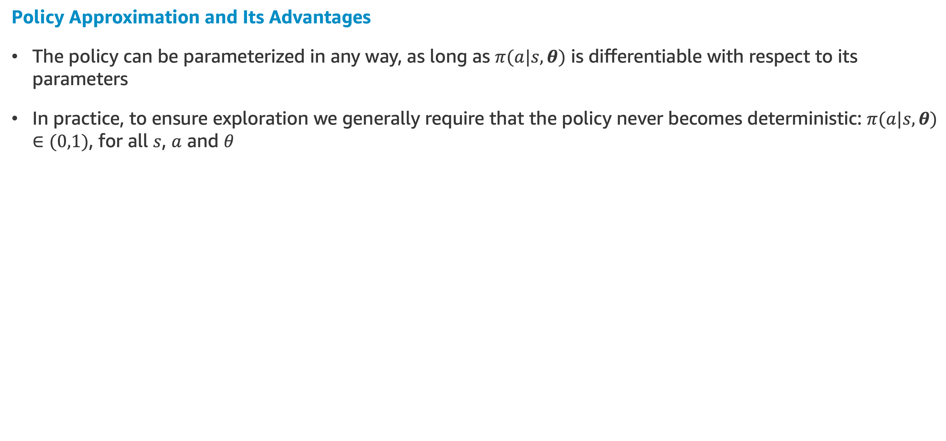
Policy Gradient Methods
Policy Approximation and Its Advantages
The policy can be parameterized in any way, as long as $π(a|s,θ)$ is differentiable with respect to its parameters
In practice, to ensure exploration we generally require that the policy never becomes deterministic: $π(a|s,θ)∈(0,1)$, for all $s$, $a$ and $θ$

Slide 14
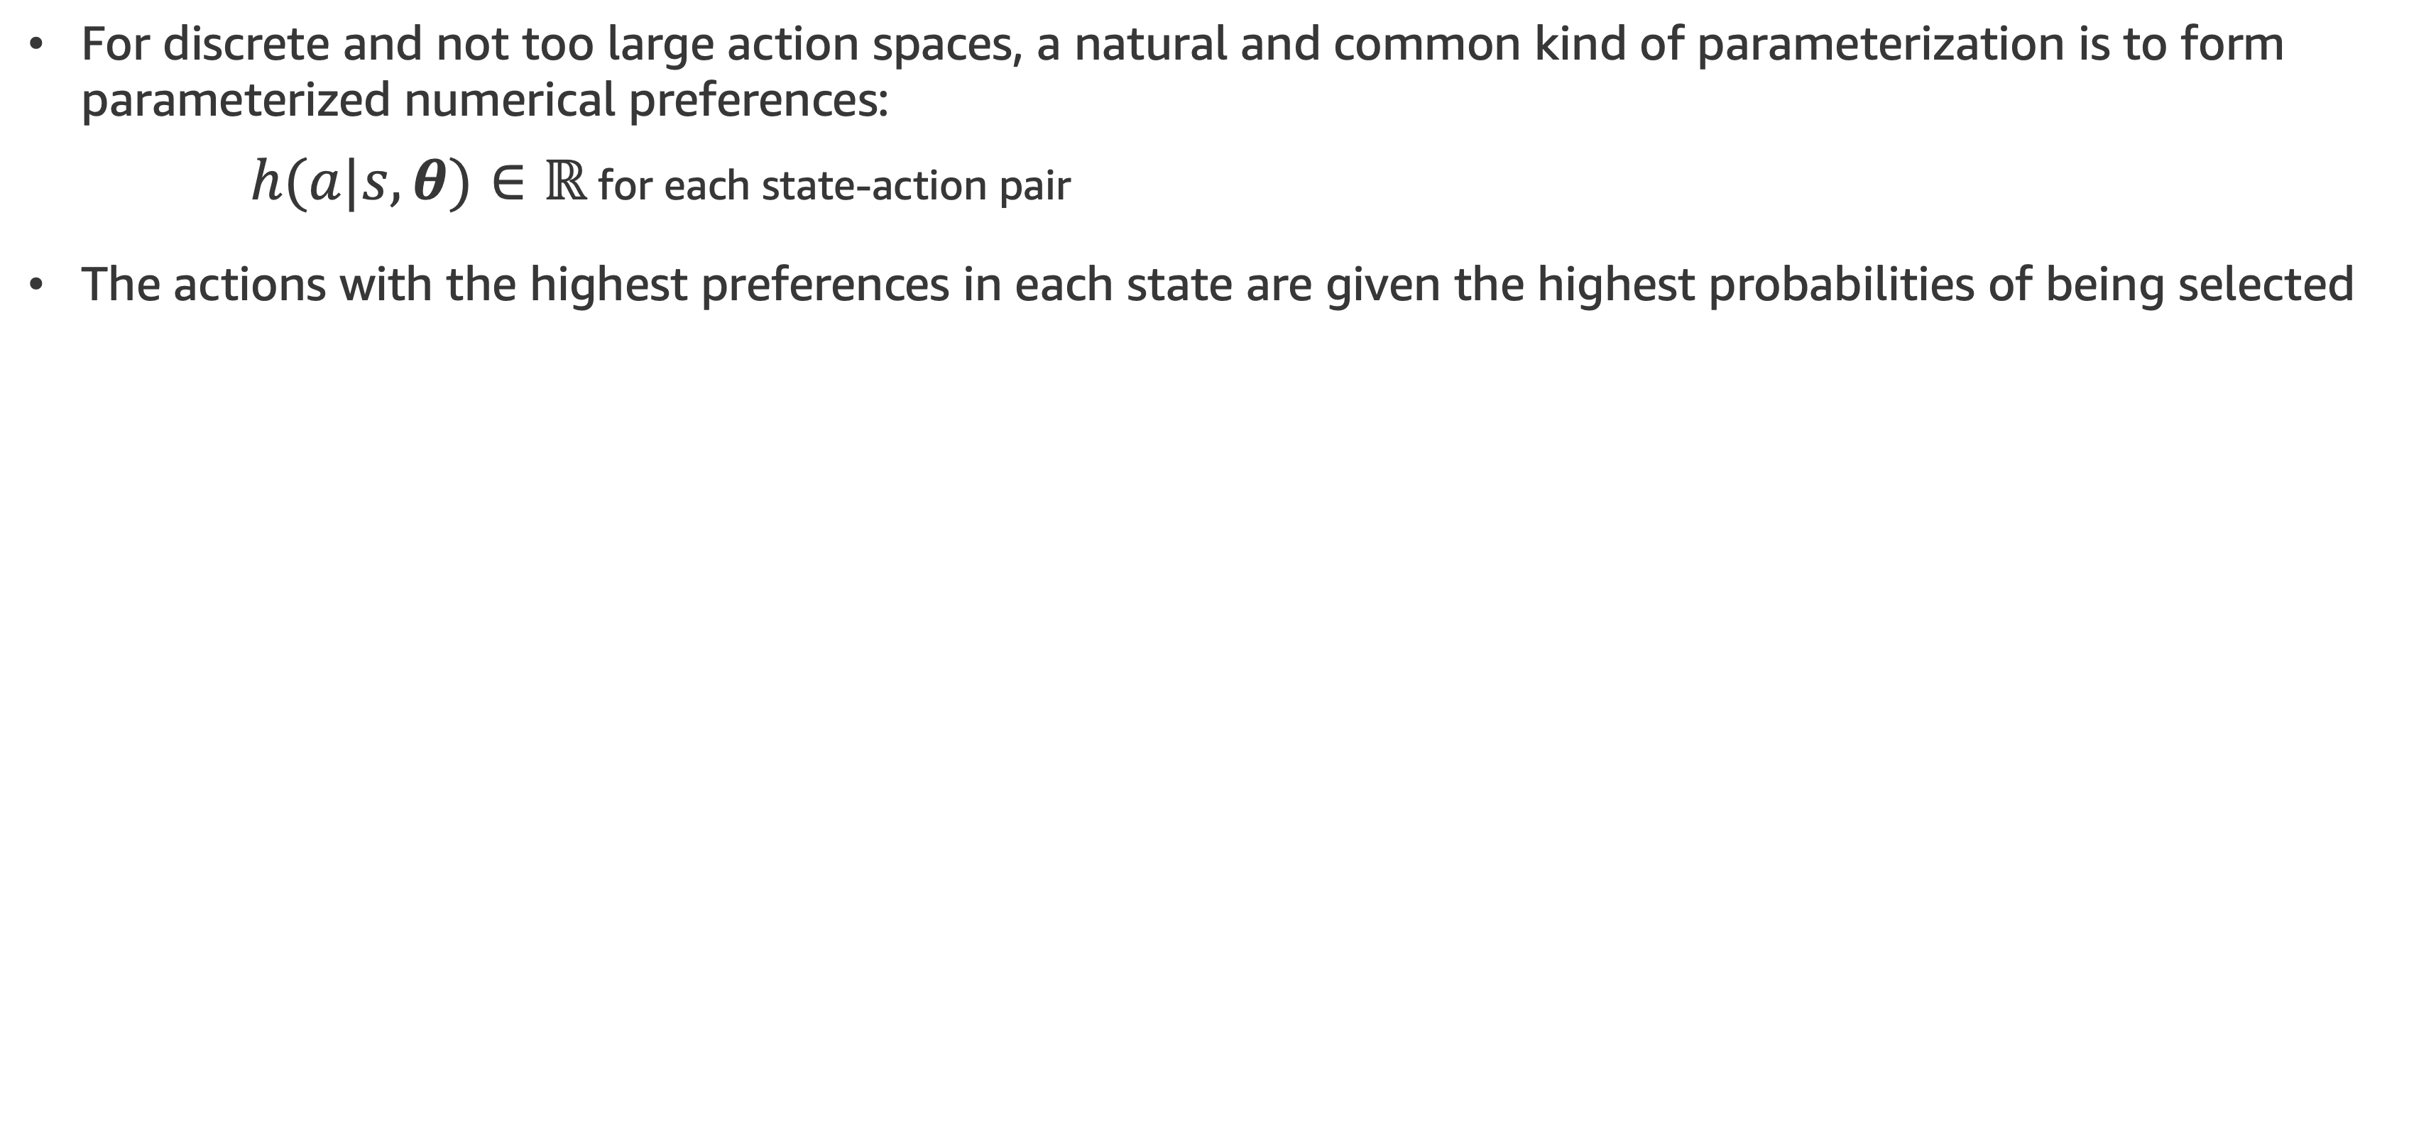
Policy Gradient Methods
For discrete and not too large action spaces, a natural and common kind of parameterization is to form parameterized numerical preferences:
$h(a|s,θ)∈ℝ$ for each state-action pair
The actions with the highest preferences in each state are given the highest probabilities of being selected

Slide 15
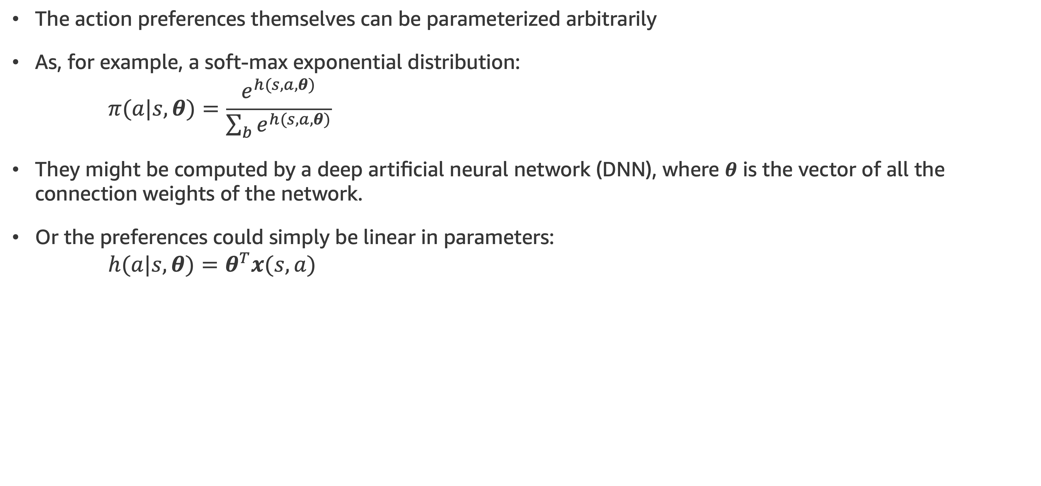
Policy Gradient Methods
The action preferences themselves can be parameterized arbitrarily
As, for example, a soft-max exponential distribution:
$$π(a|s,θ)=\frac{e^{h(s,a,θ)}}{\sum_{b}{e^{h(s,a,θ)}}}$$
They might be computed by a deep artificial neural network (DNN), where $θ$ is the vector of all the connection weights of the network.
Or the preferences could simply be linear in parameters:
$$h(a|s,θ)=θ^{T}x(s,a)$$

Slide 16
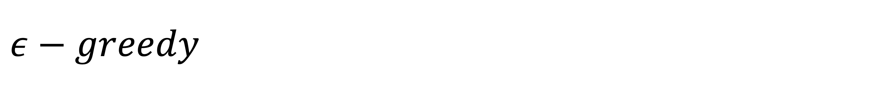
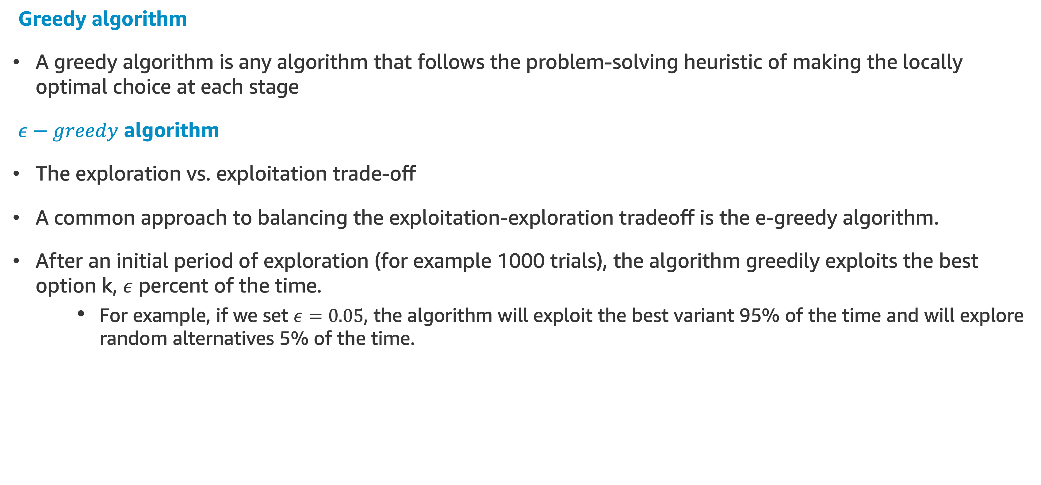
$$ε−greedy$$
Greedy algorithm
A greedy algorithm is any algorithm that follows the problem-solving heuristic of making the locally optimal choice at each stage
$ε−greedy$ algorithm
The exploration vs. exploitation trade-off
A common approach to balancing the exploitation-exploration tradeoff is the e-greedy algorithm.
After an initial period of exploration (for example 1000 trials), the algorithm greedily exploits the best option k, $ε$ percent of the time.
For example, if we set $ε=0.05$, the algorithm will exploit the best variant 95% of the time and will explore random alternatives 5% of the time.

Slide 17
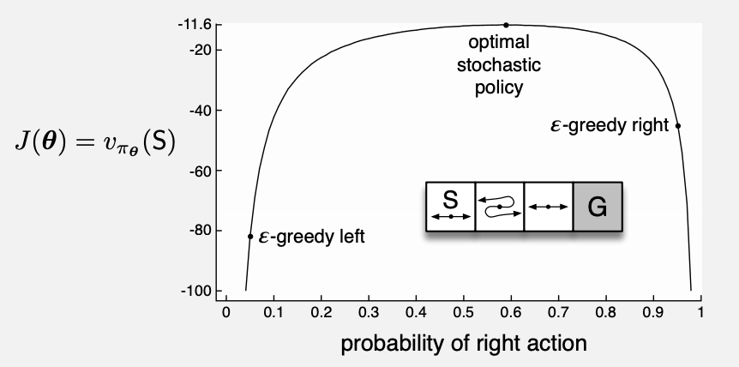
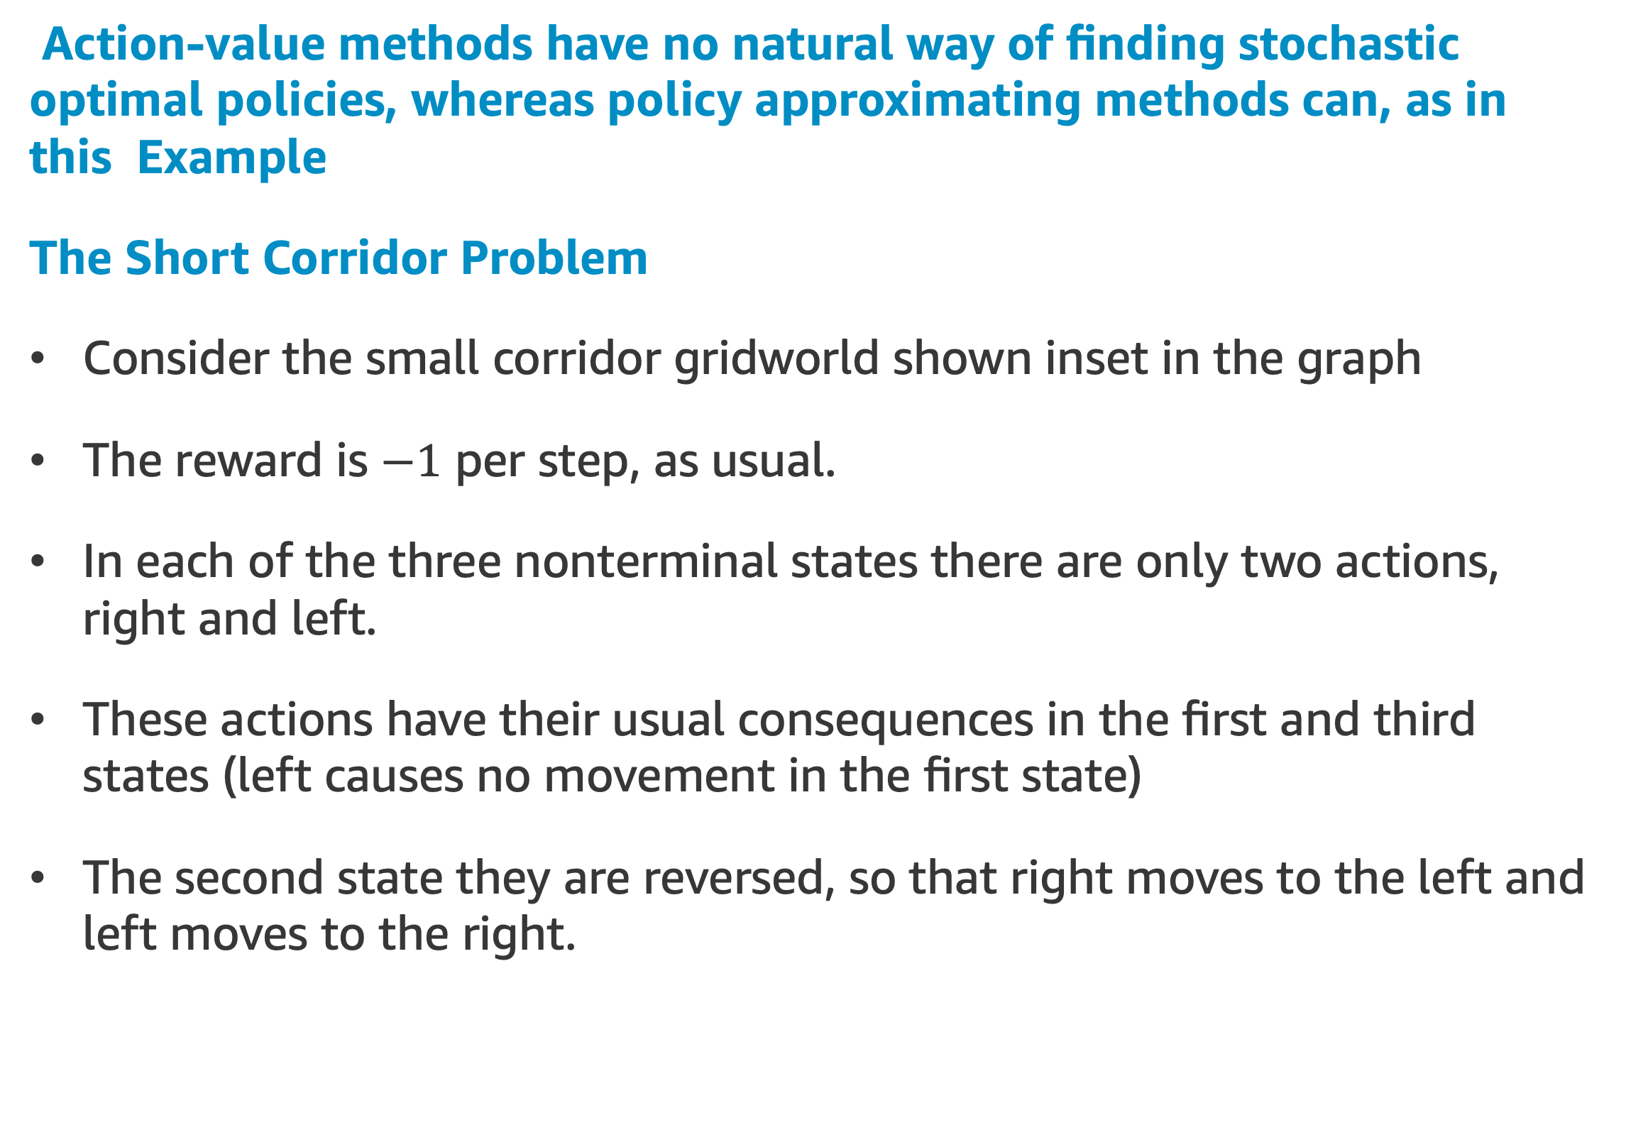
Policy Gradient Methods
Action-value methods have no natural way of finding stochastic optimal policies, whereas policy approximating methods can, as in this Example
The Short Corridor Problem
Consider the small corridor gridworld shown inset in the graph
The reward is $−1$ per step, as usual.
In each of the three nonterminal states there are only two actions, right and left.
These actions have their usual consequences in the first and third states (left causes no movement in the first state)
The second state they are reversed, so that right moves to the left and left moves to the right.

Slide 18
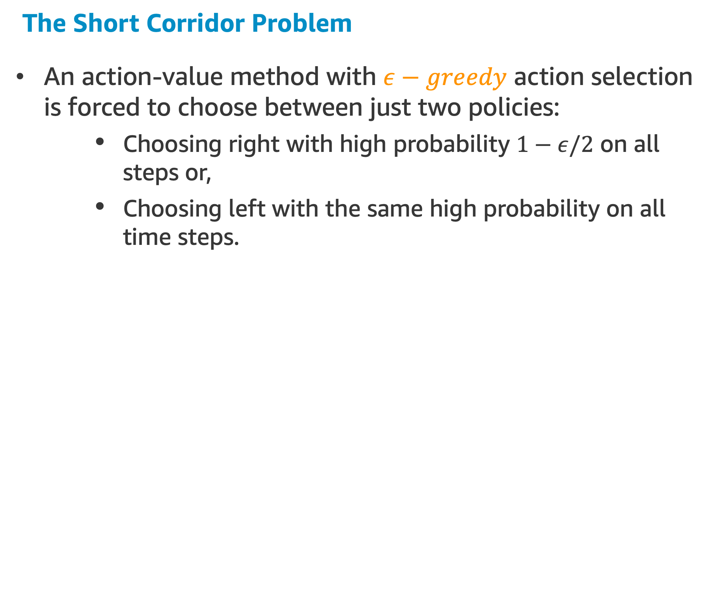
Policy Gradient Methods
The Short Corridor Problem
An action-value method with $ε−greedy$ action selection is forced to choose between just two policies:
Choosing right with high probability $1−ε/2$ on all steps or,
Choosing left with the same high probability on all time steps.

Slide 19
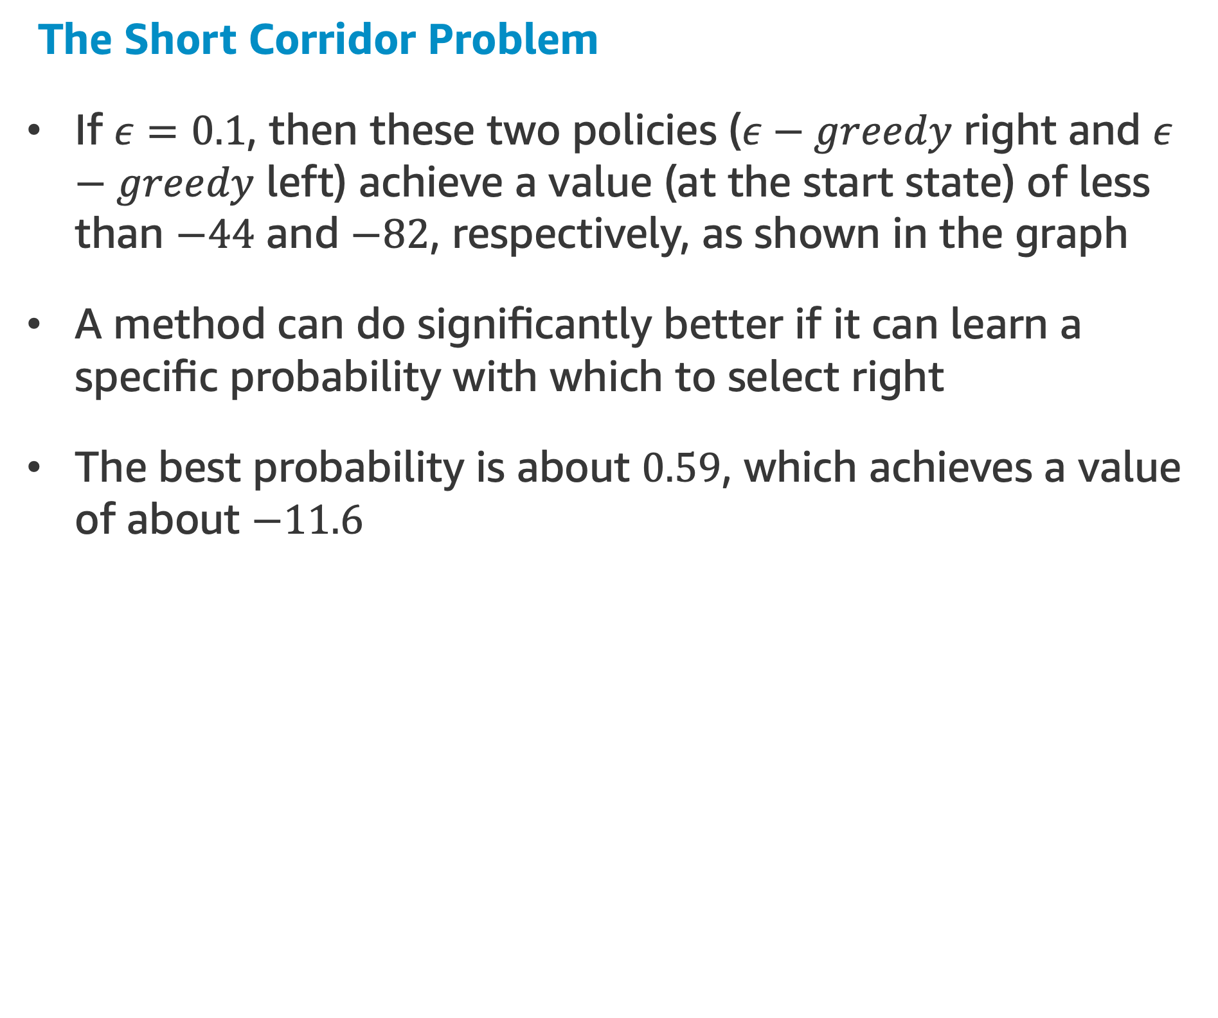
Policy Gradient Methods
The Short Corridor Problem
If $ε=0.1$, then these two policies ($ε−greedy$ right and $ε−greedy$ left) achieve a value (at the start state) of less than $−44$ and $−82$, respectively, as shown in the graph
A method can do significantly better if it can learn a specific probability with which to select right
The best probability is about $0.59$, which achieves a value of about $−11.6$
Let’s do some coding! The Short Corridor Problem
NEXT TOPIC: Linear & High order Approximators

Slide 20
Policy Gradient Theorem

Slide 21
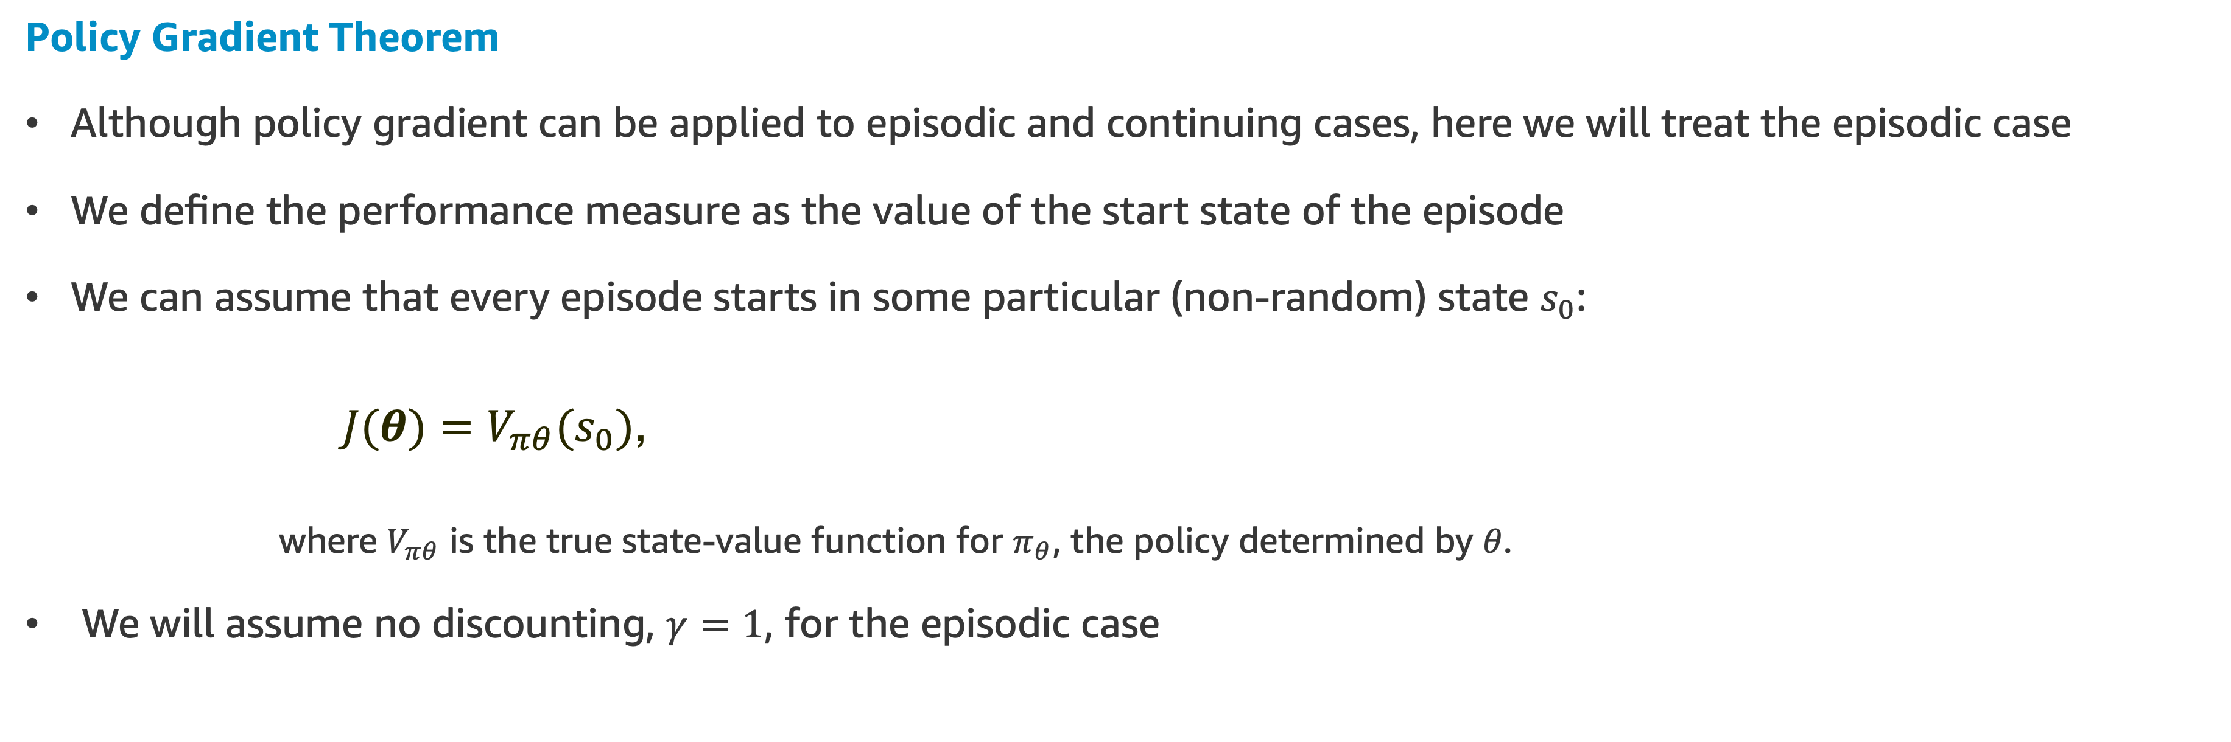
Policy Gradient Theorem
Policy Gradient Theorem
Although policy gradient can be applied to episodic and continuing cases, here we will treat the episodic case
We define the performance measure as the value of the start state of the episode
We can assume that every episode starts in some particular (non-random) state $s_{0}$:
$J(θ)=V_{πθ}(s_{0})$,
where $V_{πθ}$ is the true state-value function for $π_{θ}$, the policy determined by $θ$.
We will assume no discounting, $γ=1$, for the episodic case

Slide 22
Policy Gradient Theorem
Problem
Given a state, the effect of the policy parameter on the actions, and thus on reward, can be computed in a relatively straightforward way if we have the knowledge of the parameterization
But the effect of the policy and its parameters on the value-state distribution is a function of the environment and is typically unknown
So, how estimate the performance gradient with respect to the policy parameter when the gradient depends on the unknown effect of policy changes on the value-state distribution?
Solution
The Policy Gradient Theorem

Slide 23
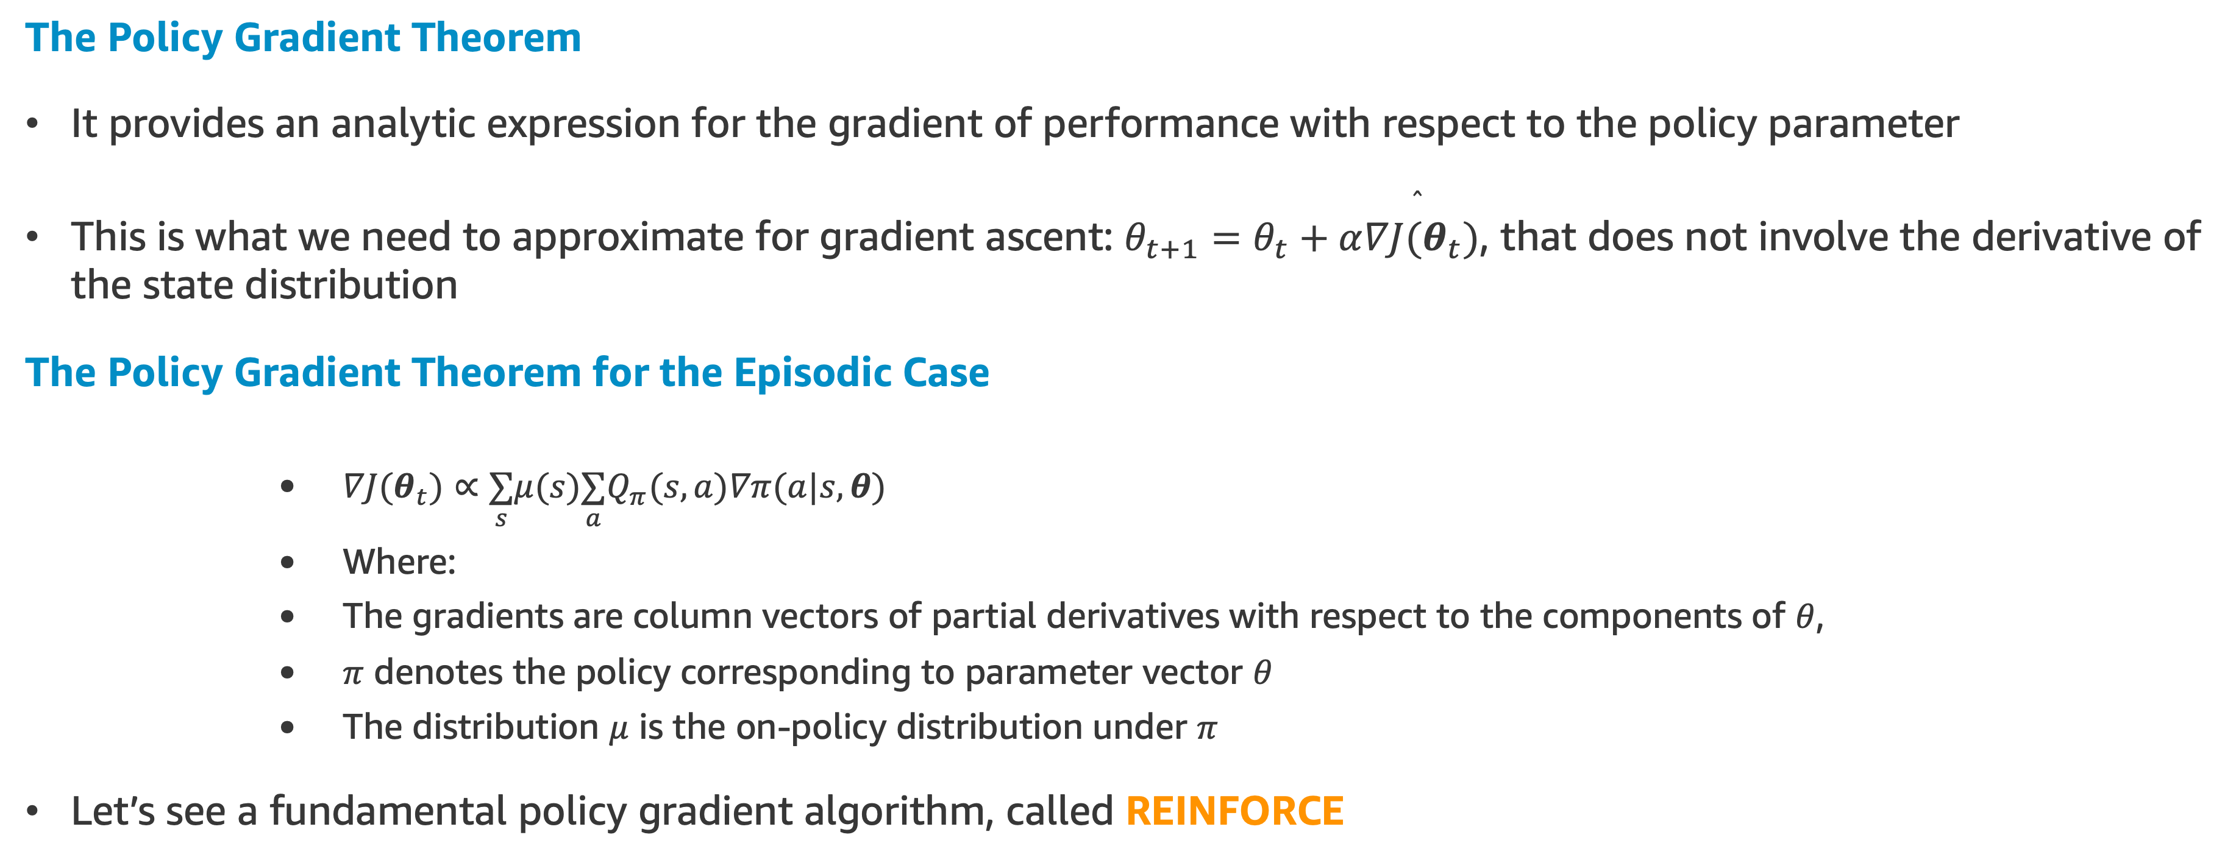
Policy Gradient Theorem
The Policy Gradient Theorem
It provides an analytic expression for the gradient of performance with respect to the policy parameter
This is what we need to approximate for gradient ascent: $θ_{t+1}=θ_{t}+α\overset{̂}{∇J(θ_{t})}$, that does not involve the derivative of the state distribution
The Policy Gradient Theorem for the Episodic Case
$∇J(θ_{t})∝\underset{s}{∑}μ(s)\underset{a}{∑}Q_{π}(s,a)∇π(a|s,θ)$
Where:
The gradients are column vectors of partial derivatives with respect to the components of $θ$,
$π$ denotes the policy corresponding to parameter vector $θ$
The distribution $μ$ is the on-policy distribution under $π$
Let’s see a fundamental policy gradient algorithm, called REINFORCE
NEXT TOPIC: REINFORCE
Notes:
proportional

Slide 24
REINFORCE Monte Carlo Policy Gradient

Slide 25
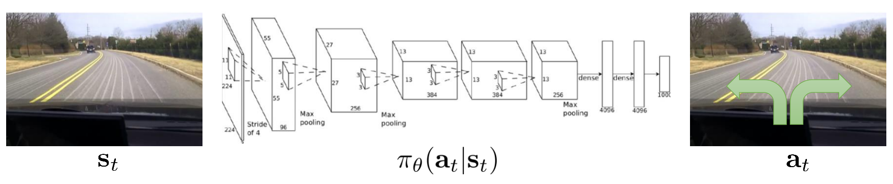
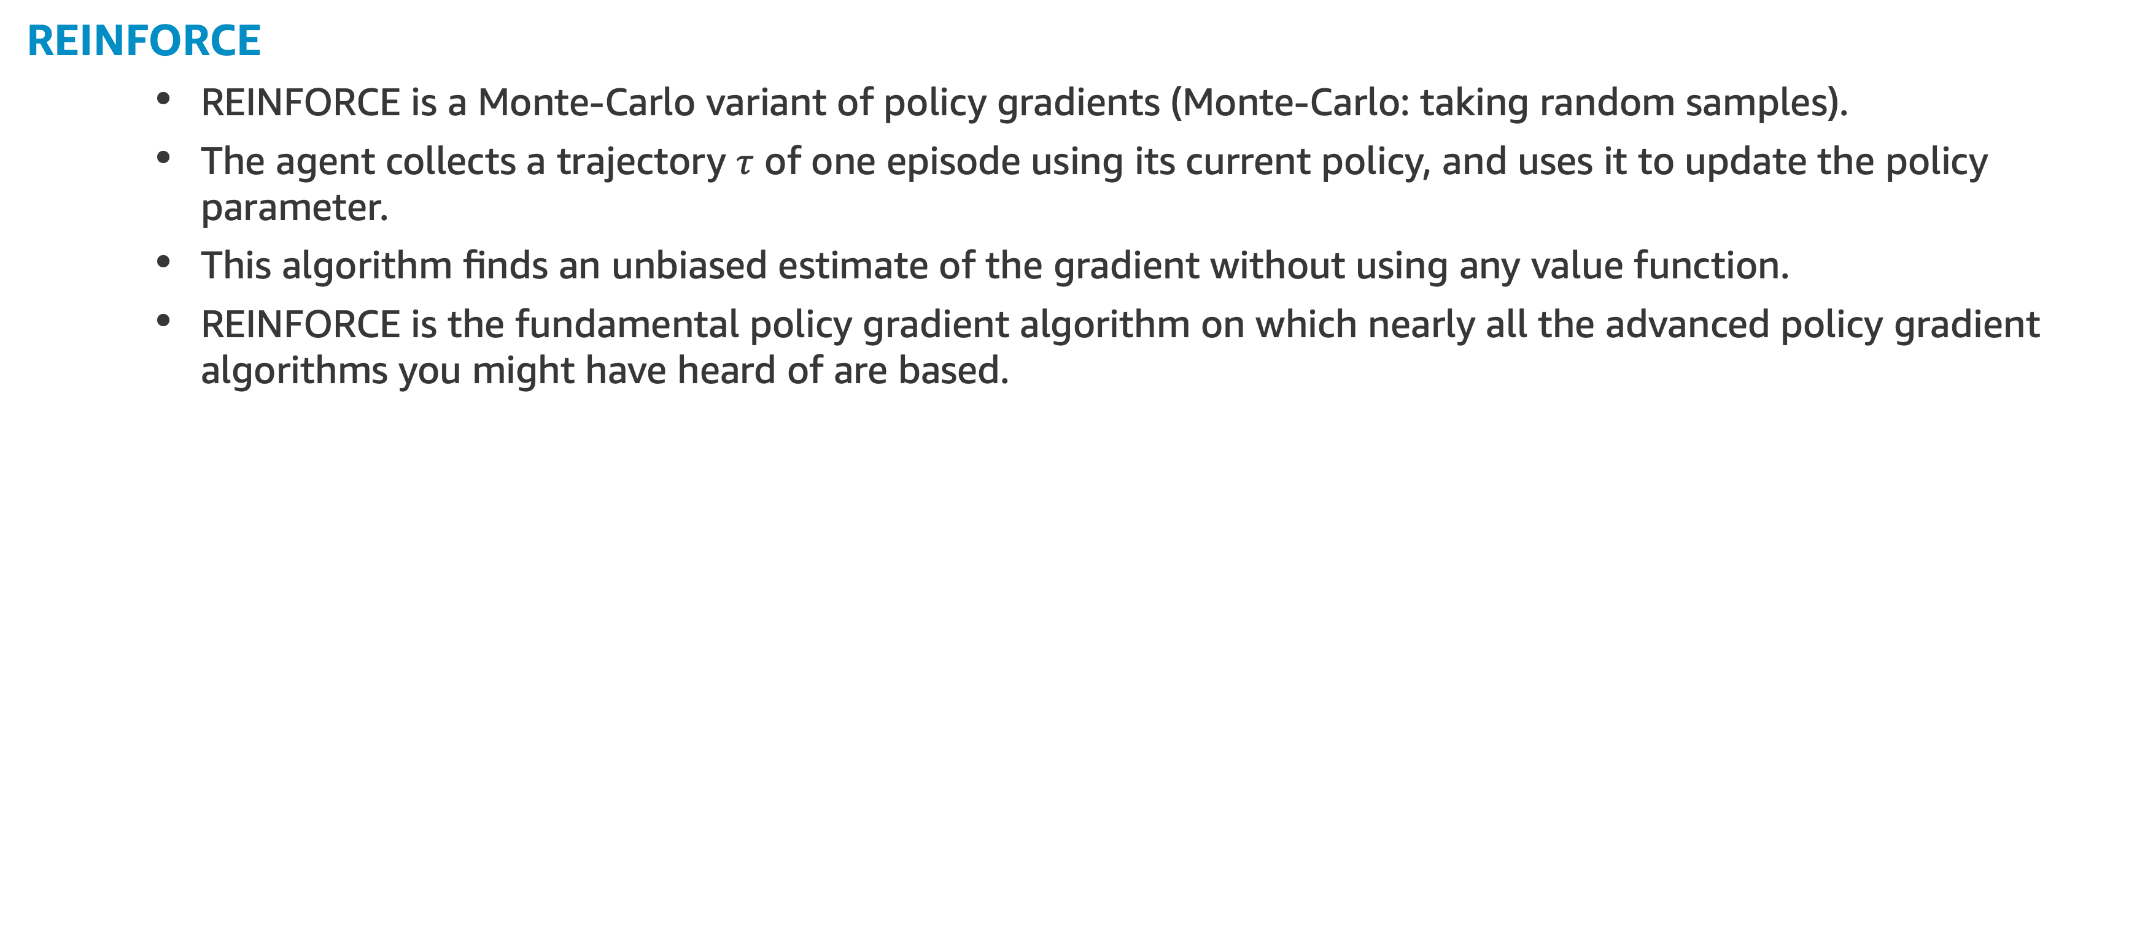
REINFORCE
REINFORCE
REINFORCE is a Monte-Carlo variant of policy gradients (Monte-Carlo: taking random samples).
The agent collects a trajectory $τ$ of one episode using its current policy, and uses it to update the policy parameter.
This algorithm finds an unbiased estimate of the gradient without using any value function.
REINFORCE is the fundamental policy gradient algorithm on which nearly all the advanced policy gradient algorithms you might have heard of are based.

Slide 26
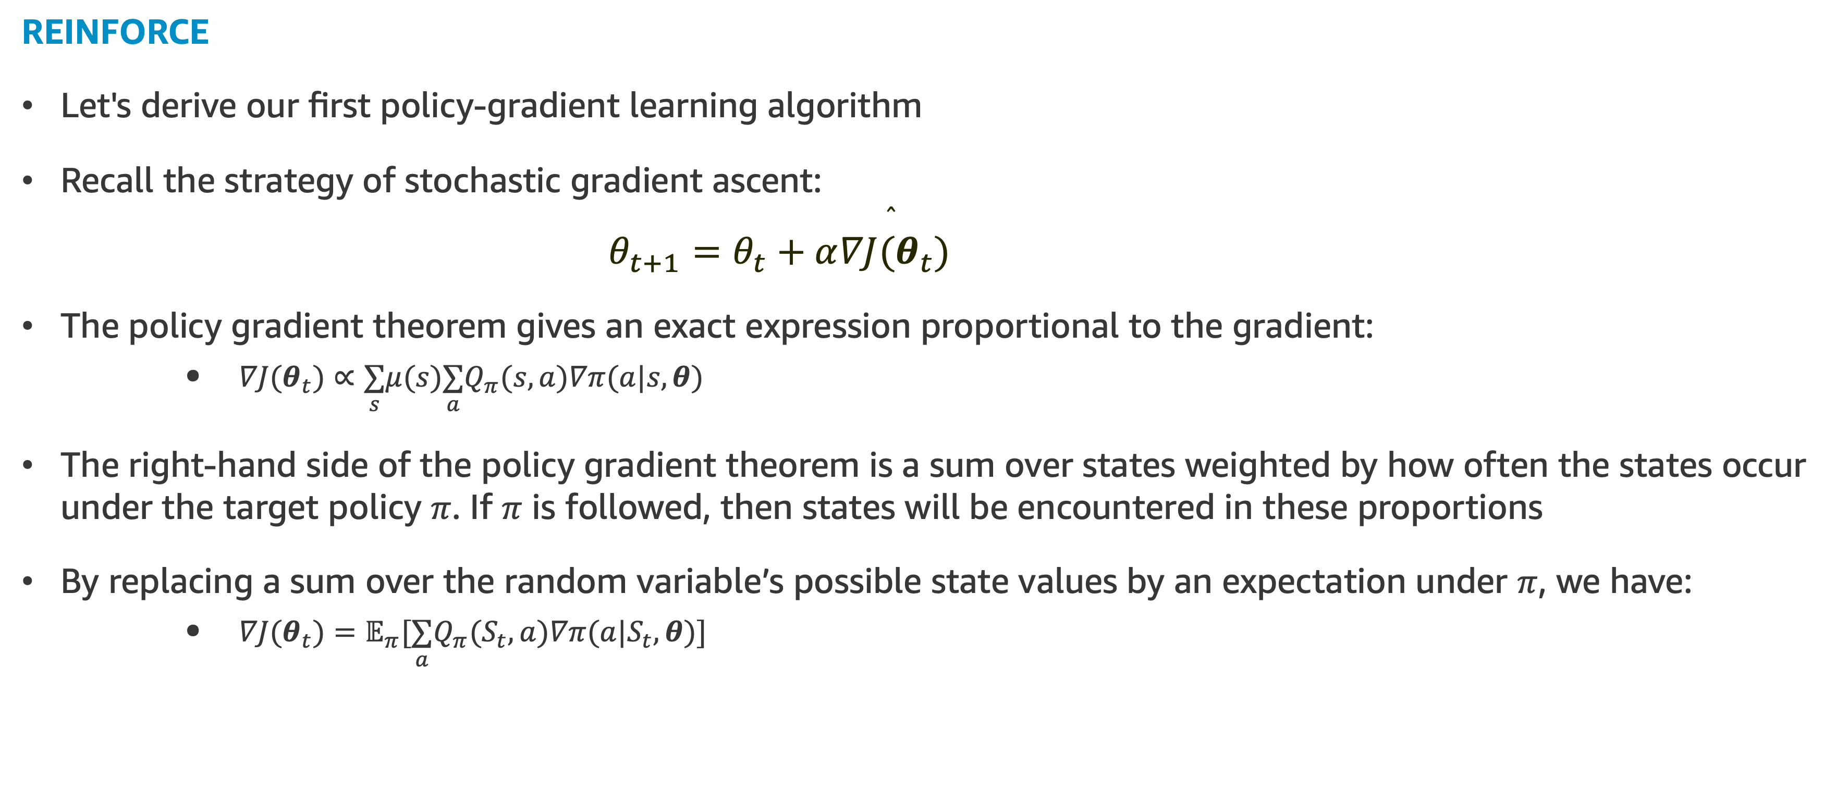
REINFORCE: Monte Carlo Policy Gradient
REINFORCE
Let's derive our first policy-gradient learning algorithm
Recall the strategy of stochastic gradient ascent:
$$θ_{t+1}=θ_{t}+α\overset{̂}{∇J(θ_{t})}$$
The policy gradient theorem gives an exact expression proportional to the gradient:
$∇J(θ_{t})∝\underset{s}{∑}μ(s)\underset{a}{∑}Q_{π}(s,a)∇π(a|s,θ)$
The right-hand side of the policy gradient theorem is a sum over states weighted by how often the states occur under the target policy $π$. If $π$ is followed, then states will be encountered in these proportions
By replacing a sum over the random variable’s possible state values by an expectation under $π$, we have:
$∇J(θ_{t})=𝔼_{π}[\underset{a}{∑}Q_{π}(S_{t},a)∇π(a|S_{t},θ)]$

Slide 27
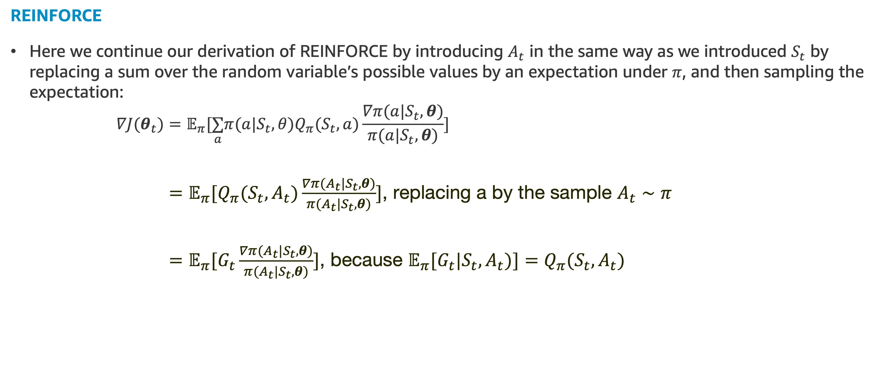
REINFORCE: Monte Carlo Policy Gradient
REINFORCE
Here we continue our derivation of REINFORCE by introducing $A_{t}$ in the same way as we introduced $S_{t}$ by replacing a sum over the random variable’s possible values by an expectation under $π$, and then sampling the expectation:
$$∇J(θ_{t})=𝔼_{π}[\underset{a}{∑}π(a|S_{t},θ)Q_{π}(S_{t},a)\frac{∇π(a|S_{t},θ)}{π(a|S_{t},θ)}]$$
$=𝔼_{π}[Q_{π}(S_{t},A_{t})\frac{∇π(A_{t}|S_{t},θ)}{π(A_{t}|S_{t},θ)}]$, replacing a by the sample $A_{t}∼π$
$=𝔼_{π}[G_{t}\frac{∇π(A_{t}|S_{t},θ)}{π(A_{t}|S_{t},θ)}]$, because $𝔼_{π}[G_{t}|S_{t},A_{t})]=Q_{π}(S_{t},A_{t})$
Notes:
By replaning

Slide 28
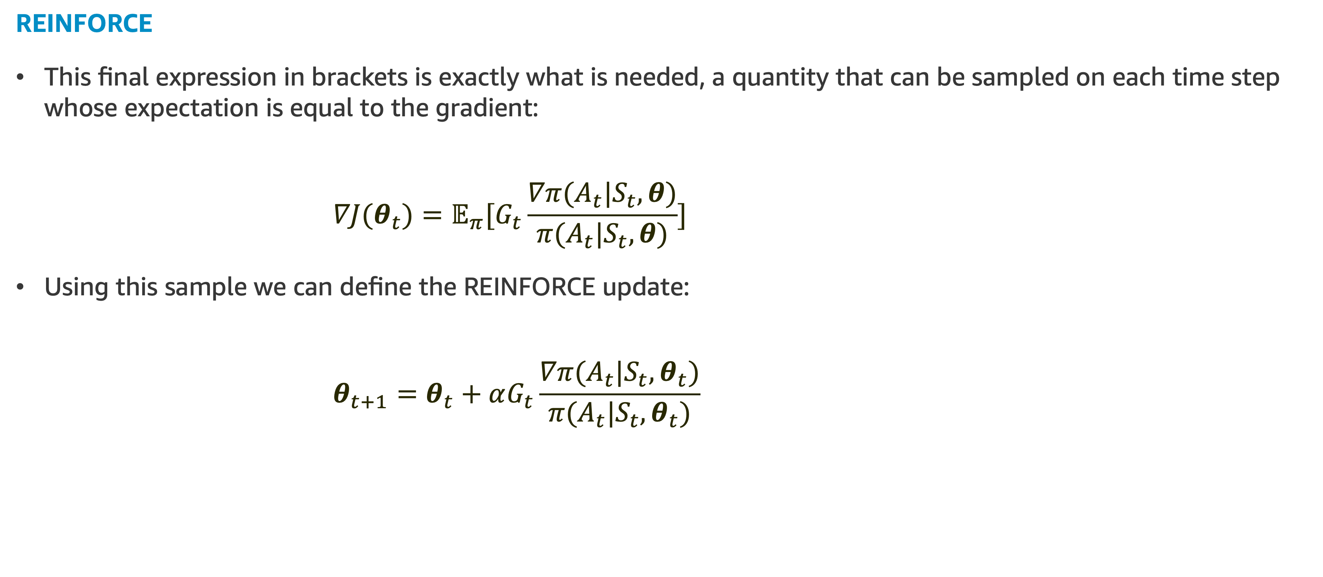
REINFORCE: Monte Carlo Policy Gradient
REINFORCE
This final expression in brackets is exactly what is needed, a quantity that can be sampled on each time step whose expectation is equal to the gradient:
$$∇J(θ_{t})=𝔼_{π}[G_{t}\frac{∇π(A_{t}|S_{t},θ)}{π(A_{t}|S_{t},θ)}]$$
Using this sample we can define the REINFORCE update:
$$θ_{t+1}=θ_{t}+αG_{t}\frac{∇π(A_{t}|S_{t},θ_{t})}{π(A_{t}|S_{t},θ_{t})}$$
Obs. The discount factor doesn’t appear here because we are considering here $γ=1$

Slide 29
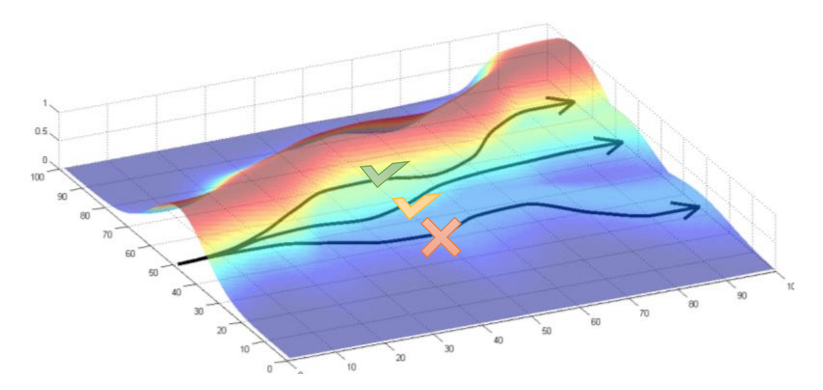
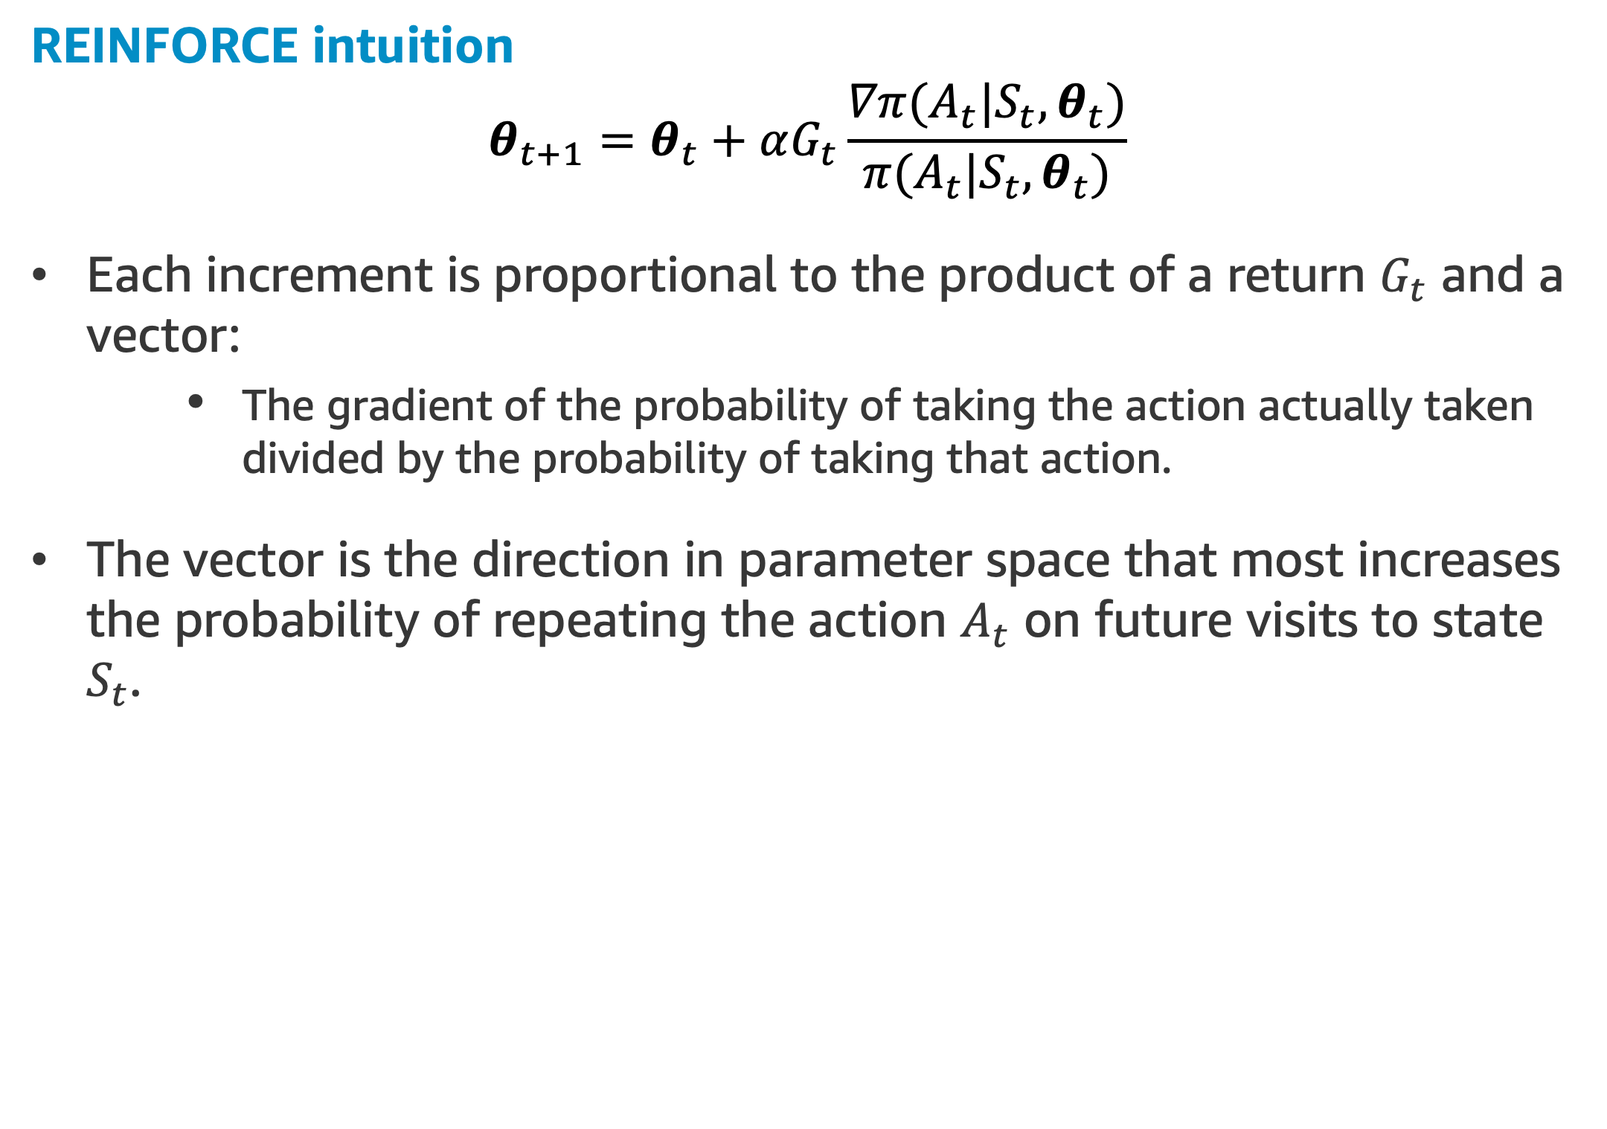
REINFORCE: Monte Carlo Policy Gradient
REINFORCE intuition
$$θ_{t+1}=θ_{t}+αG_{t}\frac{∇π(A_{t}|S_{t},θ_{t})}{π(A_{t}|S_{t},θ_{t})}$$
Each increment is proportional to the product of a return $G_{t}$ and a vector:
The gradient of the probability of taking the action actually taken divided by the probability of taking that action.
The vector is the direction in parameter space that most increases the probability of repeating the action $A_{t}$ on future visits to state $S_{t}$.

Slide 30
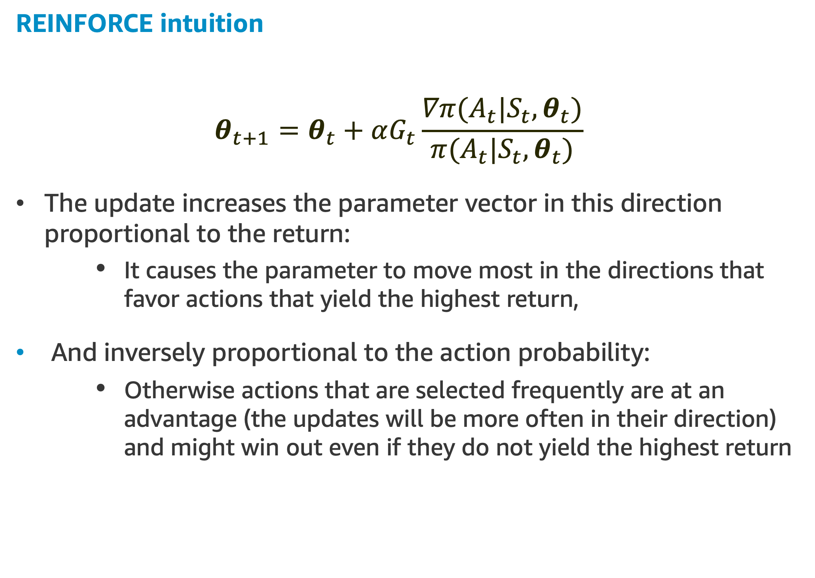
REINFORCE: Monte Carlo Policy Gradient
REINFORCE intuition
$$θ_{t+1}=θ_{t}+αG_{t}\frac{∇π(A_{t}|S_{t},θ_{t})}{π(A_{t}|S_{t},θ_{t})}$$
The update increases the parameter vector in this direction proportional to the return:
It causes the parameter to move most in the directions that favor actions that yield the highest return,
And inversely proportional to the action probability:
Otherwise actions that are selected frequently are at an advantage (the updates will be more often in their direction) and might win out even if they do not yield the highest return

Slide 31
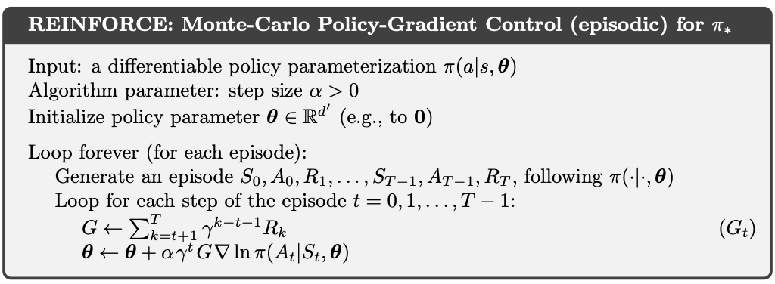
REINFORCE: Monte Carlo Policy Gradient
REINFORCE as a Monte Carlo Method
REINFORCE uses the complete return from time t, which includes all future rewards up until the end of the episode
In this sense REINFORCE is a Monte Carlo algorithm and is well defined only for the episodic case with all updates made in retrospect after the episode is completed

Slide 32
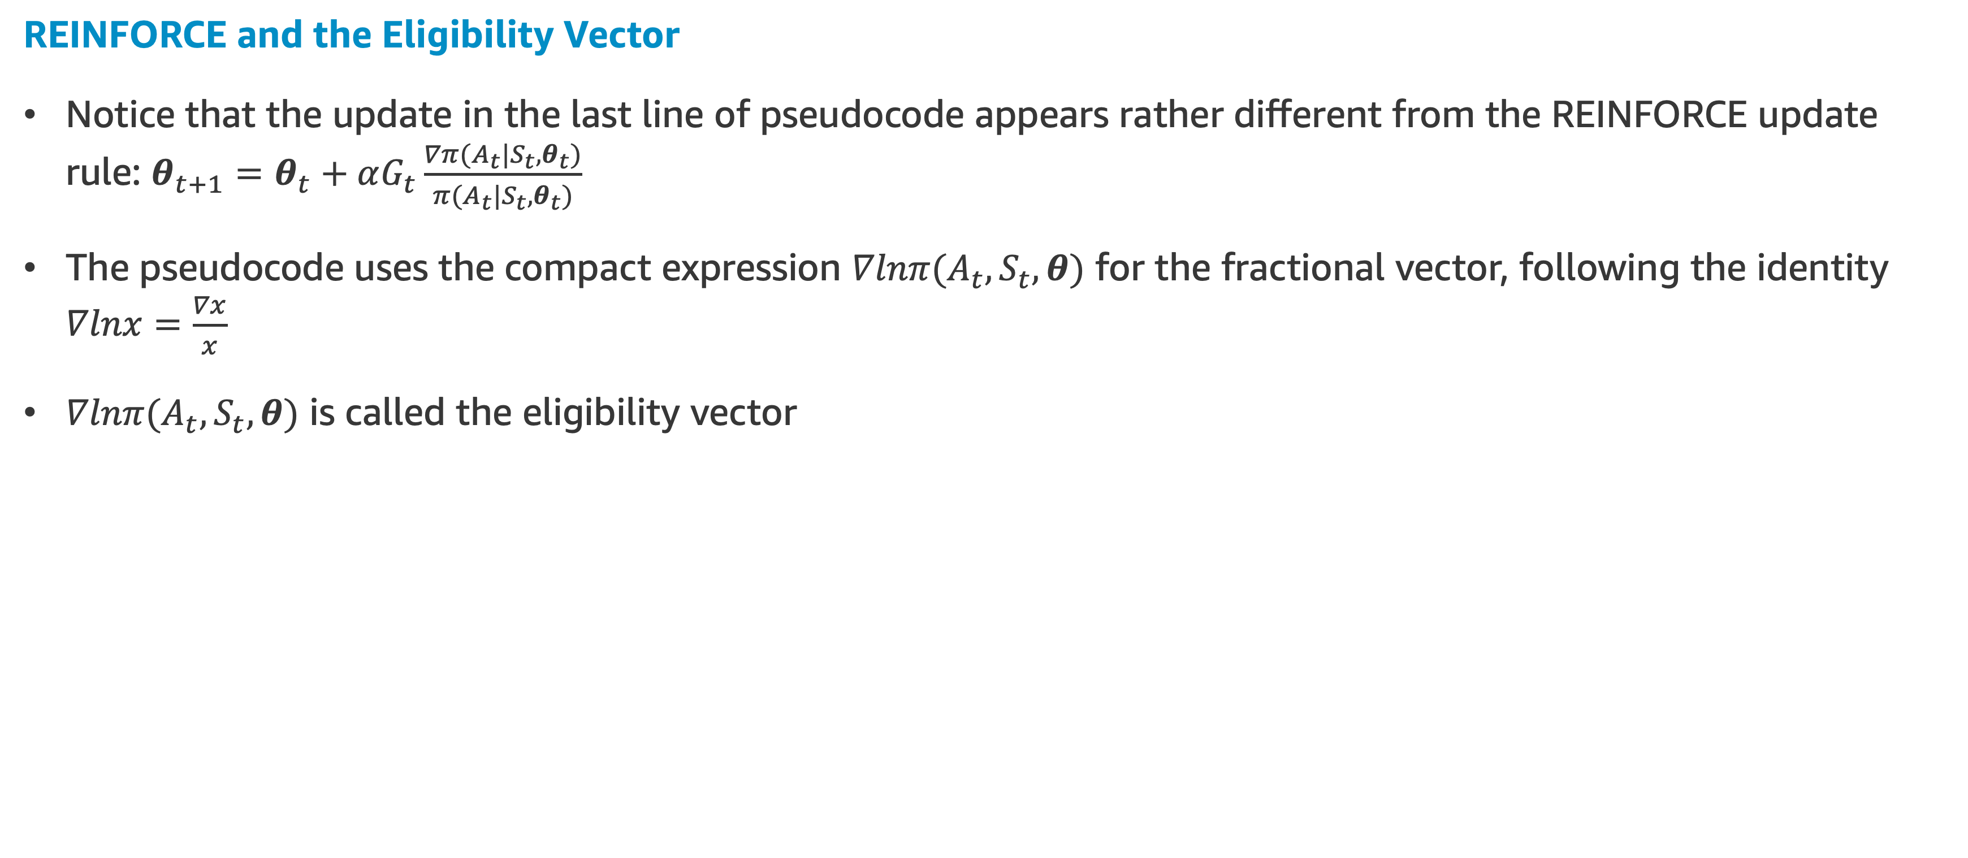
REINFORCE: Monte Carlo Policy Gradient
REINFORCE and the Eligibility Vector
Notice that the update in the last line of pseudocode appears rather different from the REINFORCE update rule: $θ_{t+1}=θ_{t}+αG_{t}\frac{∇π(A_{t}|S_{t},θ_{t})}{π(A_{t}|S_{t},θ_{t})}$
The pseudocode uses the compact expression $∇lnπ(A_{t},S_{t},θ)$ for the fractional vector, following the identity $∇lnx=\frac{∇x}{x}$
$∇lnπ(A_{t},S_{t},θ)$ is called the eligibility vector

Slide 33
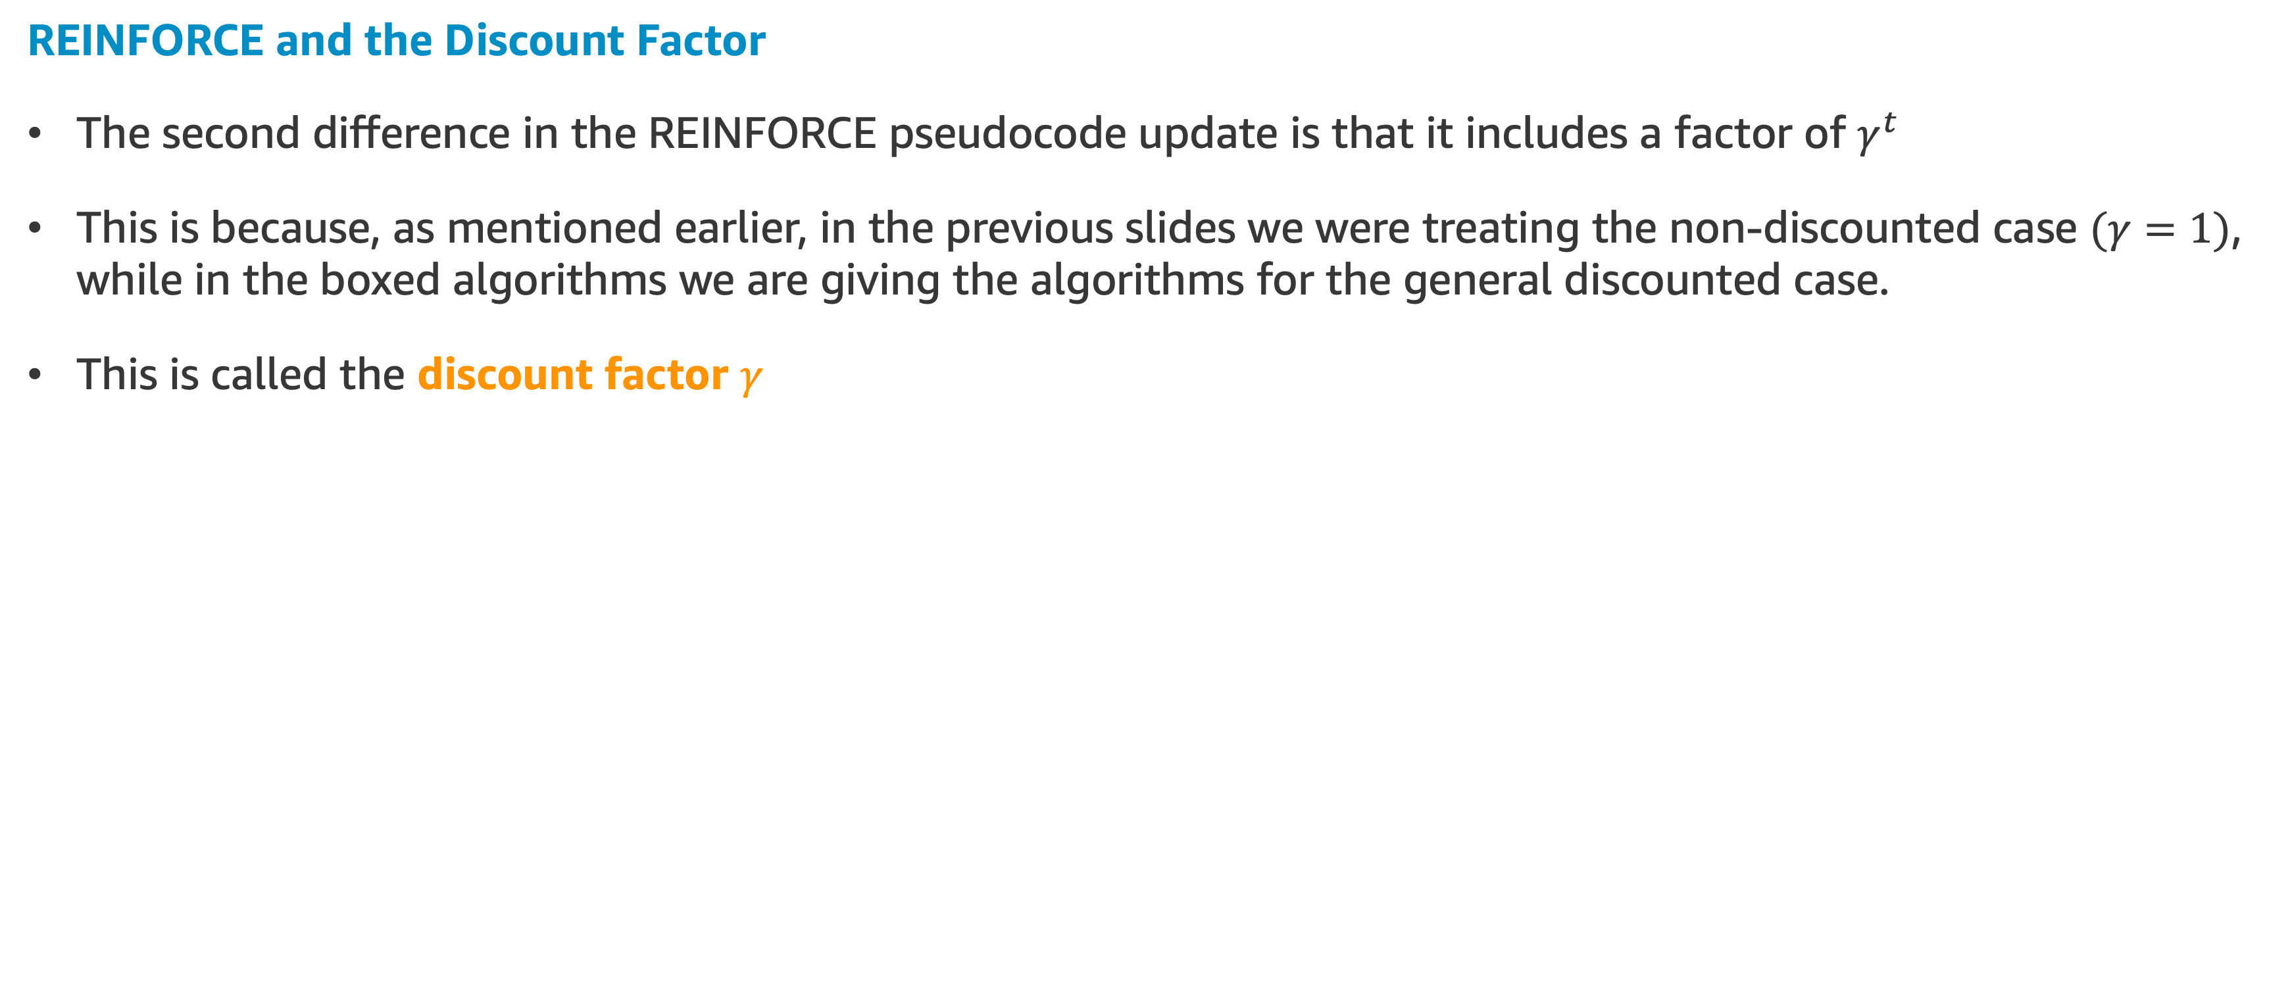
REINFORCE: Monte Carlo Policy Gradient
REINFORCE and the Discount Factor
The second difference in the REINFORCE pseudocode update is that it includes a factor of $γ^{t}$
This is because, as mentioned earlier, in the previous slides we were treating the non-discounted case $(γ=1)$, while in the boxed algorithms we are giving the algorithms for the general discounted case.
This is called the discount factor $γ$
Let’s do some coding! Short Corridor with REINFORCE
NEXT TOPIC: REINFORCE with Baseline

Slide 34
REINFORCE with Baseline

Slide 35
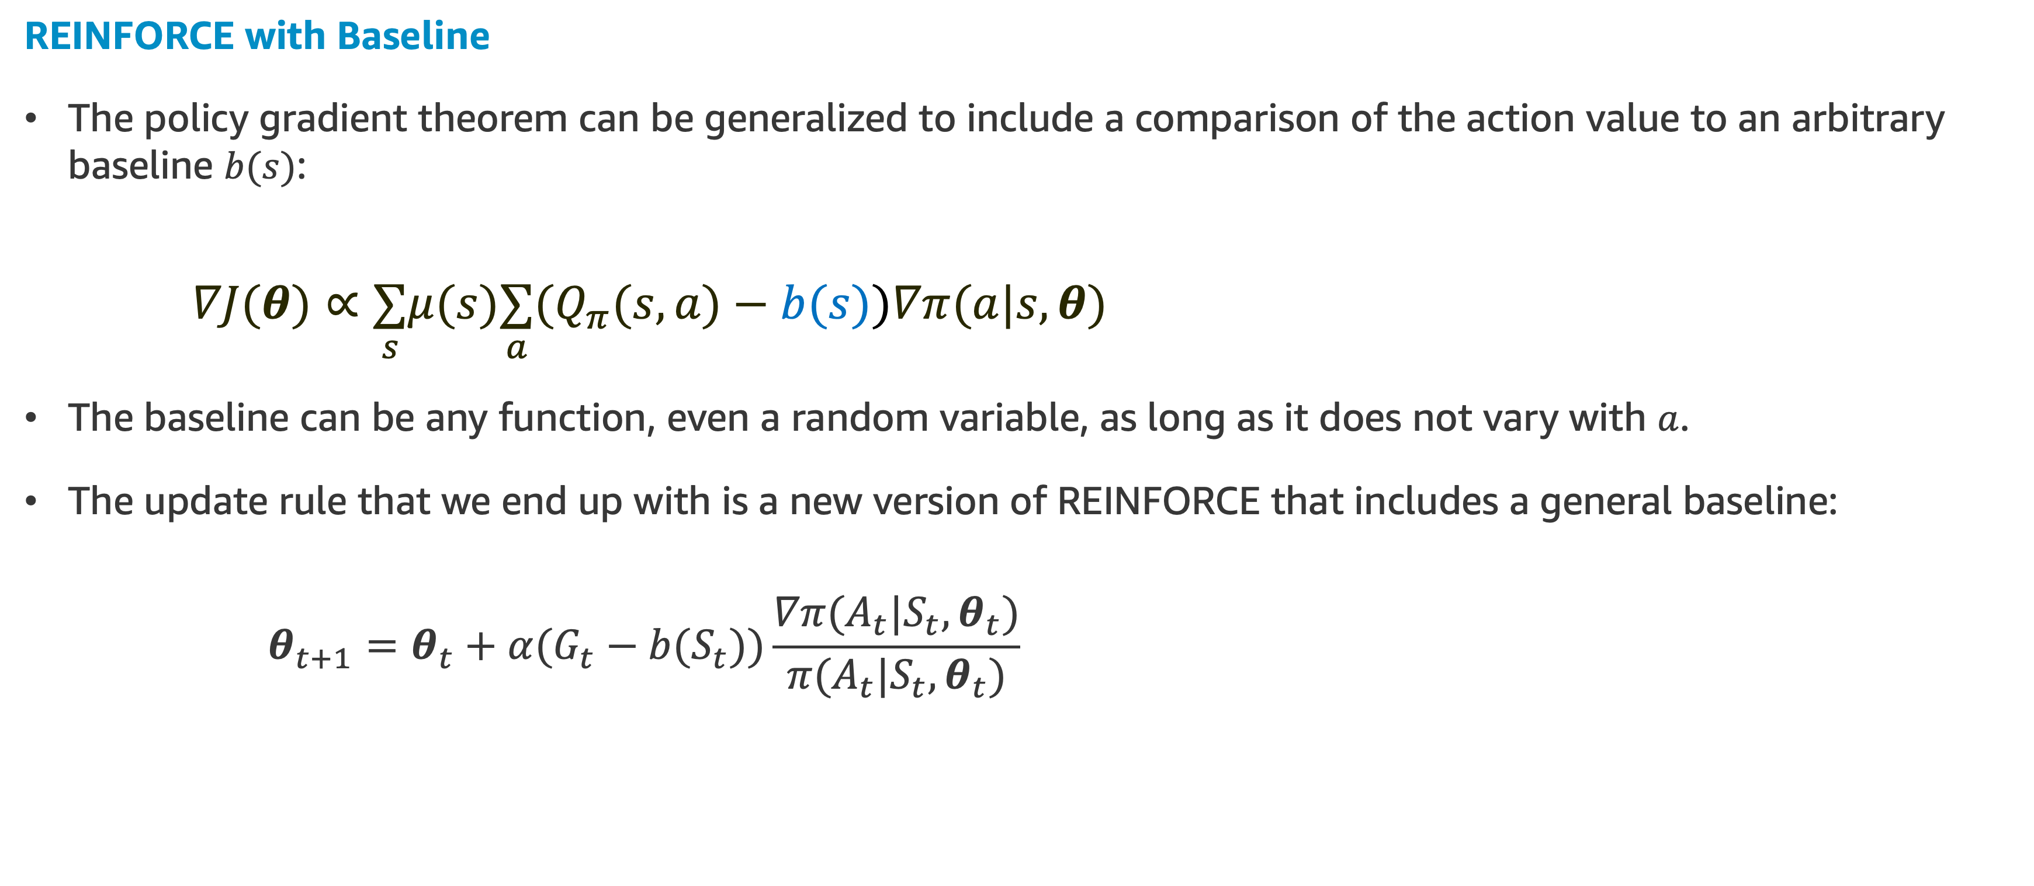
REINFORCE with Baseline
REINFORCE with Baseline
The policy gradient theorem can be generalized to include a comparison of the action value to an arbitrary baseline $b(s)$:
$$∇J(θ)∝\underset{s}{∑}μ(s)\underset{a}{∑}(Q_{π}(s,a)−b(s))∇π(a|s,θ)$$
The baseline can be any function, even a random variable, as long as it does not vary with $a$.
The update rule that we end up with is a new version of REINFORCE that includes a general baseline:
$$θ_{t+1}=θ_{t}+α(G_{t}−b(S_{t}))\frac{∇π(A_{t}|S_{t},θ_{t})}{π(A_{t}|S_{t},θ_{t})}$$

Slide 36
REINFORCE with Baseline
REINFORCE with Baseline
In general, the baseline leaves the expected value of the update unchanged, but it can have a large effect on its variance
For MDPs, the baseline should vary with state
In some states all actions have high values and we need a high baseline to differentiate the higher valued actions from the less highly valued ones.
In other states all actions will have low values and a low baseline is appropriate.

Slide 37
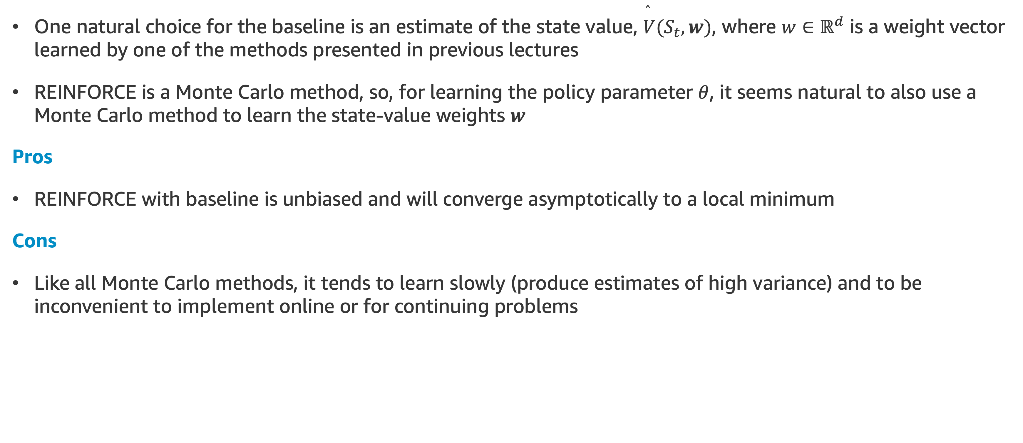
REINFORCE with Baseline
One natural choice for the baseline is an estimate of the state value, $\overset{̂}{V}(S_{t},w)$, where $w∈ℝ^{d}$ is a weight vector learned by one of the methods presented in previous lectures
REINFORCE is a Monte Carlo method, so, for learning the policy parameter $θ$, it seems natural to also use a Monte Carlo method to learn the state-value weights $w$
Pros
REINFORCE with baseline is unbiased and will converge asymptotically to a local minimum
Cons
Like all Monte Carlo methods, it tends to learn slowly (produce estimates of high variance) and to be inconvenient to implement online or for continuing problems

Slide 38
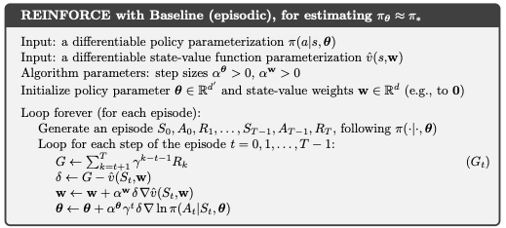
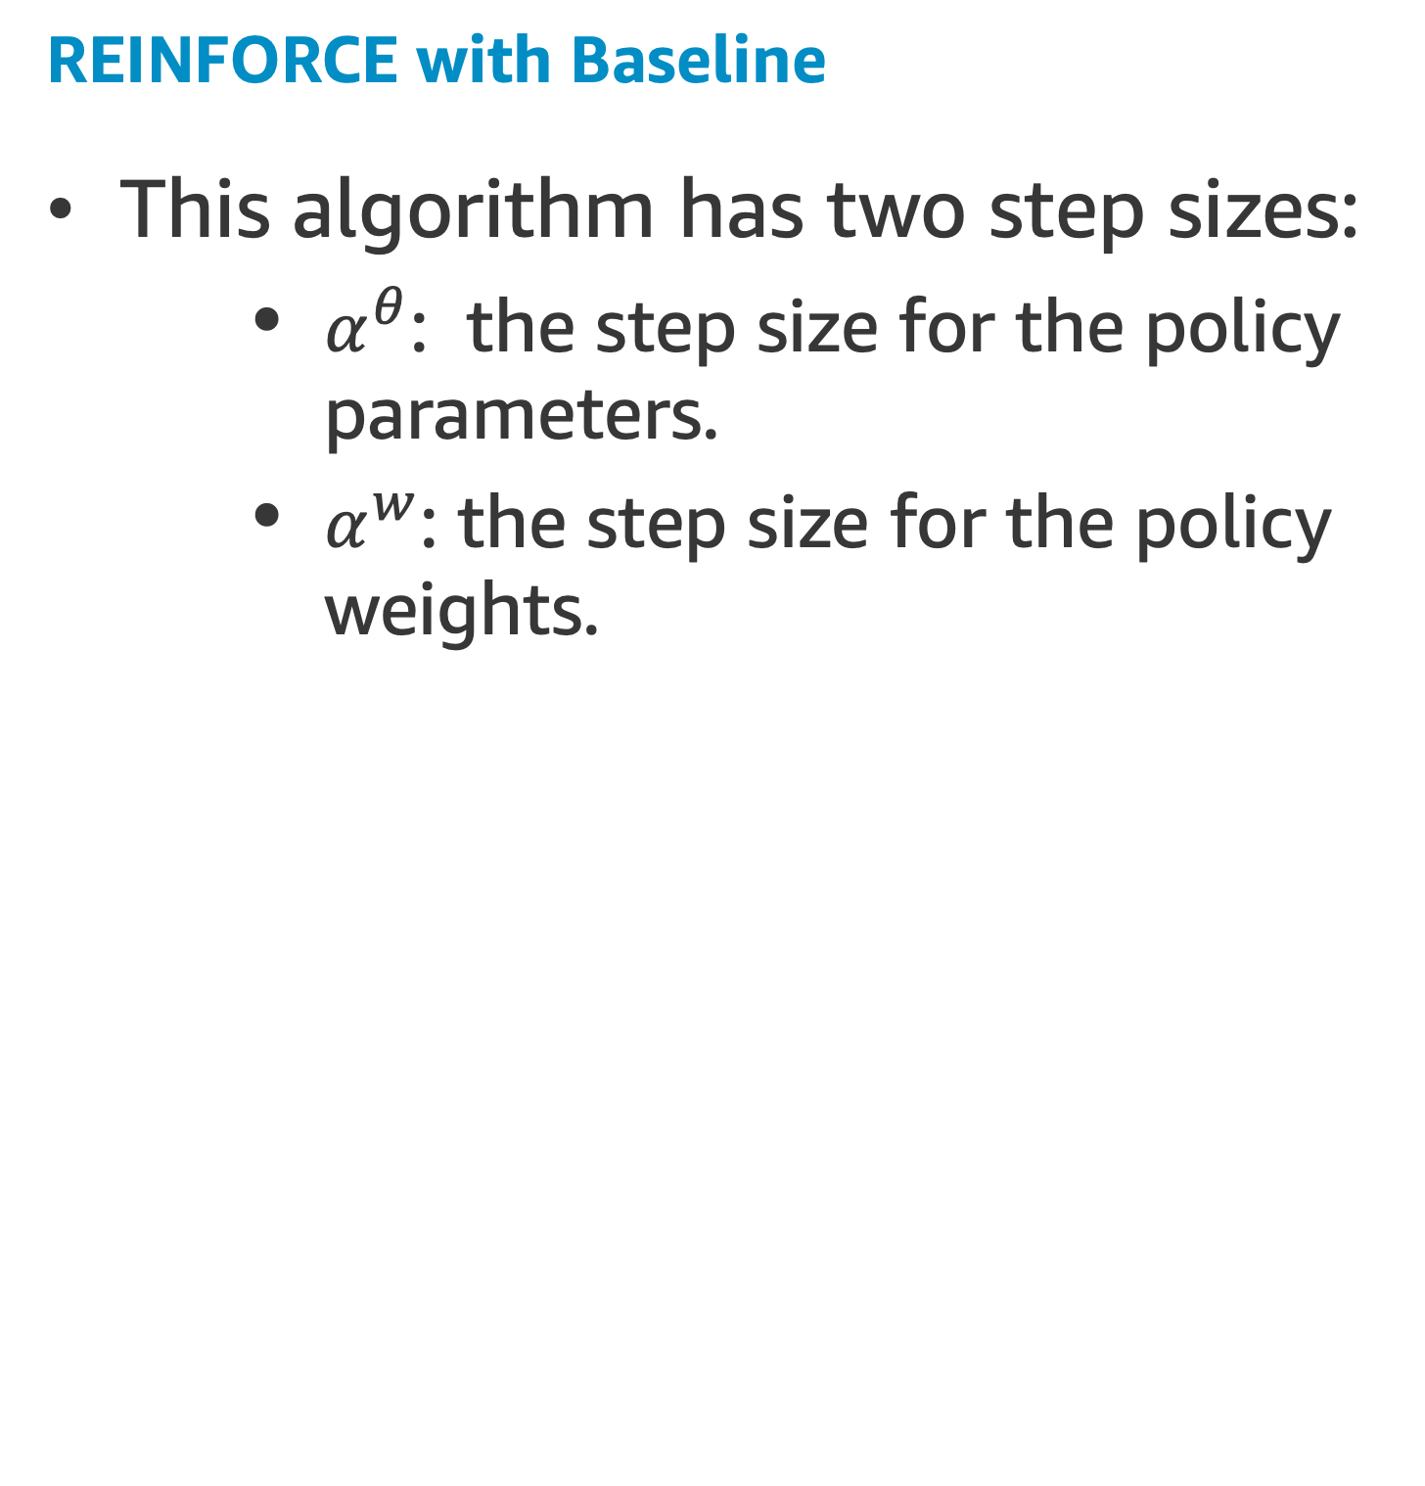
REINFORCE with Baseline
REINFORCE with Baseline
This algorithm has two step sizes:
$α^{θ}$: the step size for the policy parameters.
$α^{w}$: the step size for the policy weights.
Let’s do some coding! REINFORCE with Baseline

Slide 39
REINFORCE with Baseline vs. Actor-Critic
REINFORCE-with-baseline vs. Actor-Critic
REINFORCE-with-baseline method is not consider an actor–critic method because its state-value function is used only as a baseline, not as a critic
Meaning that it is not used for bootstrapping*, but only as a baseline for the state whose estimate is being updated
Like all Monte Carlo methods it tends to learn slowly (produce estimates of high variance) and to be inconvenient to implement online or for continuing problems
TD methods can eliminate these inconveniences, and through multi-step methods we can flexibly choose the degree of bootstrapping
In order to gain these advantages in the case of policy gradient methods we use actor–critic methods with a bootstrapping critic
* updating the value estimate for a state from the estimated values of subsequent states

Slide 40
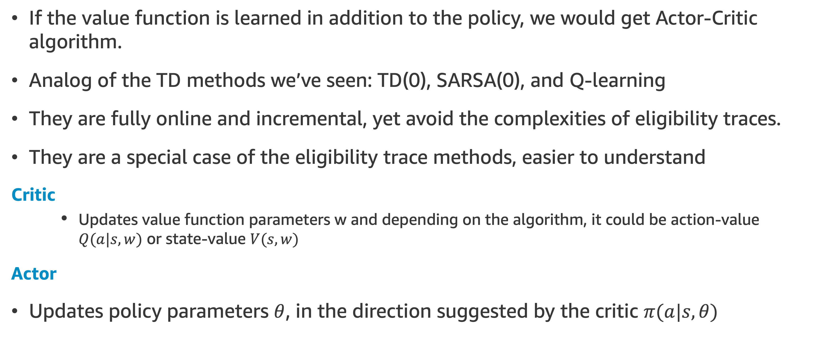
One Step Actor–Critic Methods
If the value function is learned in addition to the policy, we would get Actor-Critic algorithm.
Analog of the TD methods we’ve seen: TD(0), SARSA(0), and Q-learning
They are fully online and incremental, yet avoid the complexities of eligibility traces.
They are a special case of the eligibility trace methods, easier to understand
Critic
Updates value function parameters w and depending on the algorithm, it could be action-value $Q(a|s,w)$ or state-value $V(s,w)$
Actor
Updates policy parameters $θ$, in the direction suggested by the critic $π(a|s,θ)$

Slide 41
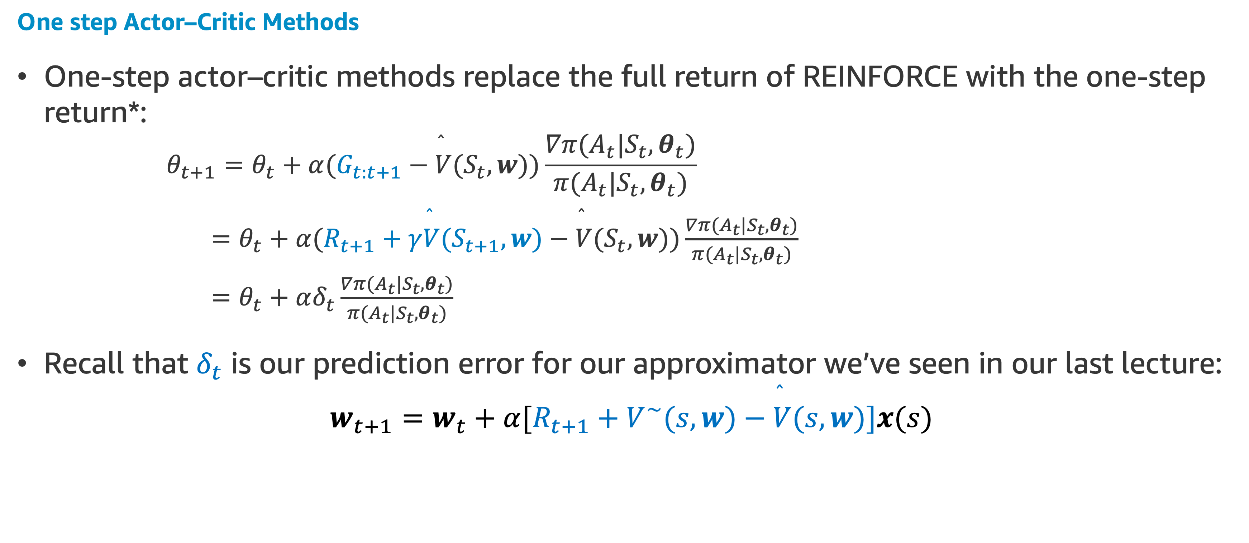
One Step Actor–Critic Methods
One step Actor–Critic Methods
One-step actor–critic methods replace the full return of REINFORCE with the one-step return*:
$$θ_{t+1}=θ_{t}+α(G_{t:t+1}−\overset{̂}{V}(S_{t},w))\frac{∇π(A_{t}|S_{t},θ_{t})}{π(A_{t}|S_{t},θ_{t})}$$
$=θ_{t}+α(R_{t+1}+γ\overset{̂}{V}(S_{t+1},w)−\overset{̂}{V}(S_{t},w))\frac{∇π(A_{t}|S_{t},θ_{t})}{π(A_{t}|S_{t},θ_{t})}$
$=θ_{t}+αδ_{t}\frac{∇π(A_{t}|S_{t},θ_{t})}{π(A_{t}|S_{t},θ_{t})}$
Recall that $δ_{t}$ is our prediction error for our approximator we’ve seen in our last lecture:
$$w_{t+1}=w_{t}+α[R_{t+1}+V^{∼}(s,w)−\overset{̂}{V}(s,w)]x(s)$$
* use a learned state-value function as the baseline

Slide 42
One Step Episodic Actor–Critic
This is now a fully online, incremental algorithm, with states, actions, and rewards processed as they occur and then never revisited
We are going to apply this algorithm to solve the Cliff walking problem
Let’s do some coding! Cliffwalkig Actor Critic for Discrete Action Spaces

Slide 43
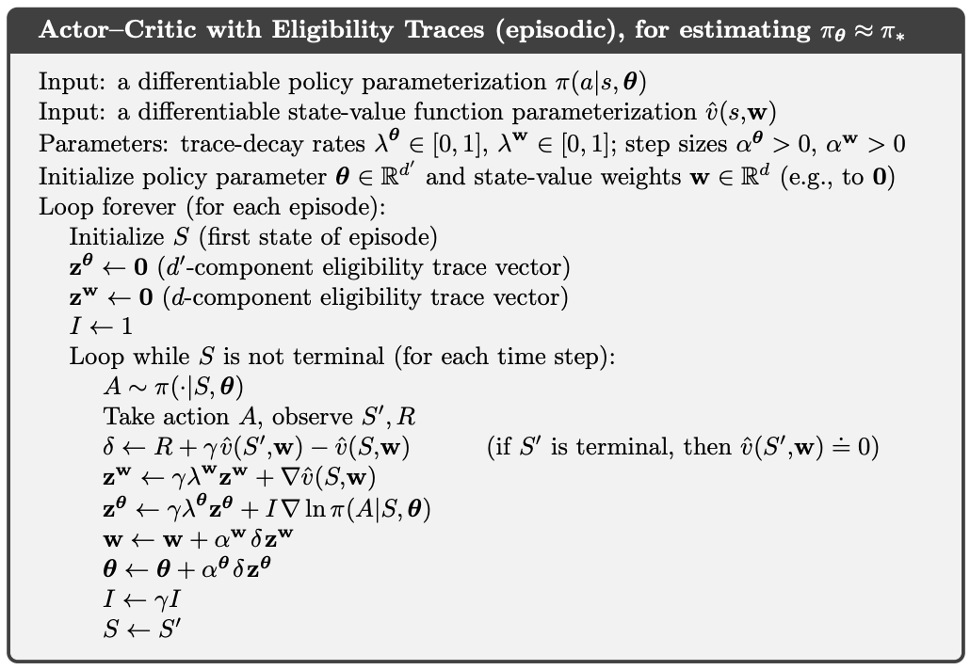
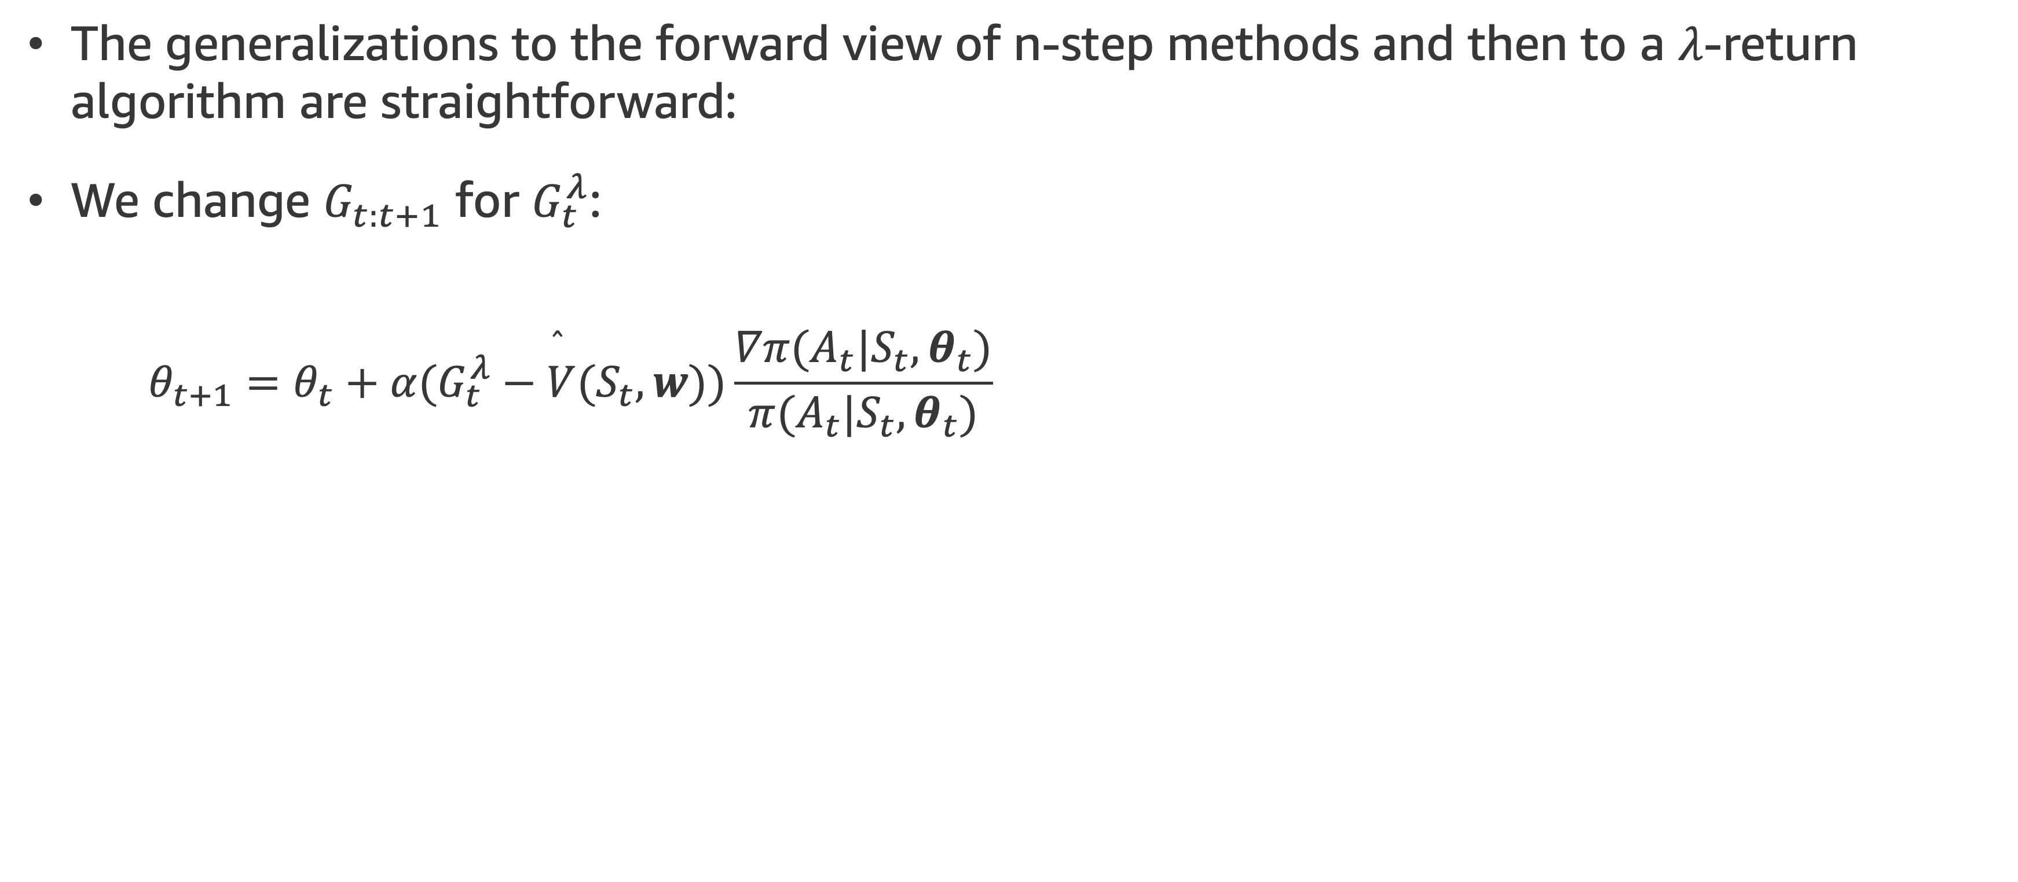
Actor Critic Episodic with Eligibility Traces
The generalizations to the forward view of n-step methods and then to a $λ$-return algorithm are straightforward:
We change $G_{t:t+1}$ for $G_{t}^{λ}$:
$$θ_{t+1}=θ_{t}+α(G_{t}^{λ}−\overset{̂}{V}(S_{t},w))\frac{∇π(A_{t}|S_{t},θ_{t})}{π(A_{t}|S_{t},θ_{t})}$$
NEXT TOPIC: Policy Gradient Descent

Slide 44
Policy Gradient Descent

Slide 45
Policy Gradient Descent
RECAP: Value based learning with Approximation
The general approach we have used in the previous lectures is a classical case of value based learning
We know that there is a Q function which can tell us exactly how good a certain move is in a certain state
We train a Neural Network to learn this Q function
When we have to make a move, we do so according to the following policy: We look at the Q values of all currently possible moves and chose the one with the highest Q value
Disadvantages
We do not know the Q function when we start training
There are circumstances where it's hard to determine how good a given situation is, however comparatively easier to determine what the best action is

Slide 46
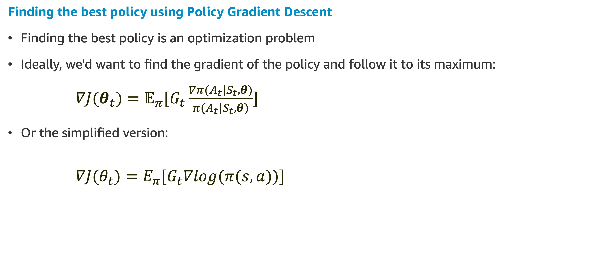
Policy Gradient Descent
Finding the best policy using Policy Gradient Descent
Finding the best policy is an optimization problem
Ideally, we'd want to find the gradient of the policy and follow it to its maximum:
$∇J(θ_{t})=𝔼_{π}[G_{t}\frac{∇π(A_{t}|S_{t},θ)}{π(A_{t}|S_{t},θ)}]$
Or the simplified version:
$$∇J(θ_{t})=E_{π}[G_{t}∇log(π(s,a))]$$

Slide 47
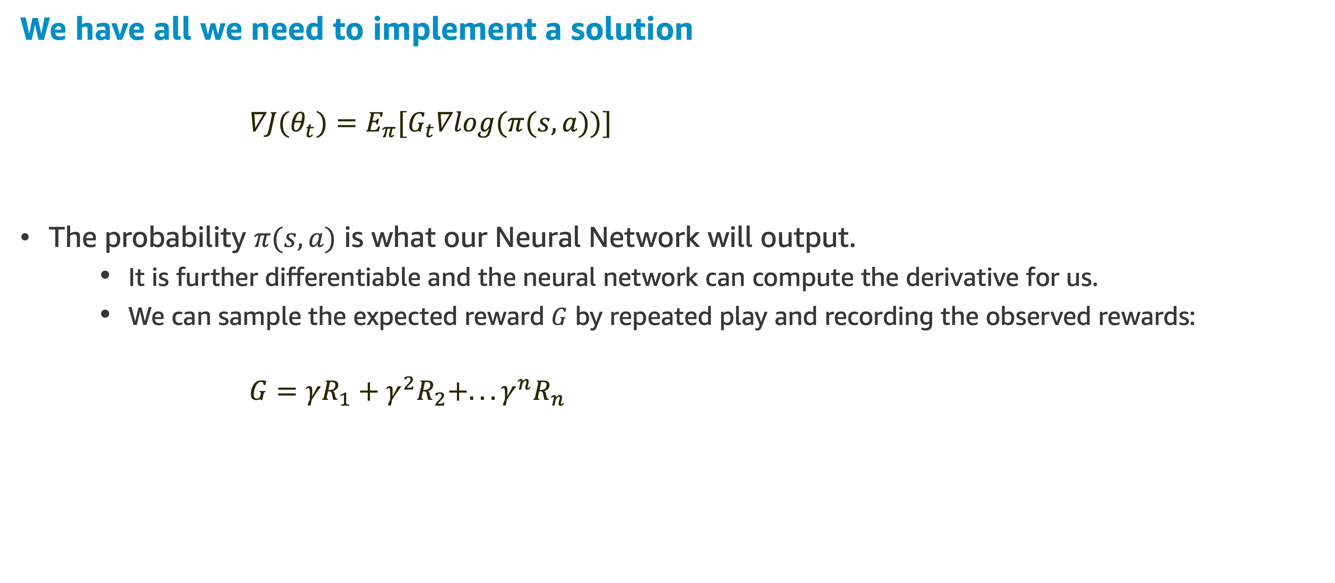
Policy Gradient Descent
We have all we need to implement a solution
$$∇J(θ_{t})=E_{π}[G_{t}∇log(π(s,a))]$$
The probability $π(s,a)$ is what our Neural Network will output.
It is further differentiable and the neural network can compute the derivative for us.
We can sample the expected reward $G$ by repeated play and recording the observed rewards:
$$G=γR_{1}+γ^{2}R_{2}+...γ^{n}R_{n}$$

Slide 48
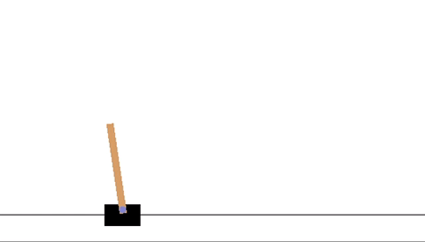
Policy Gradient Descent Example
A Simple Policy Gradient Descent Example
It is not in the scope of this course to discuss Deep Learning implementations
But we will show in general lines how to implement a policy gradient for a simple CartPole Problem

Slide 49
Policy Gradient Descent Example
CartPole with Policy Gradient
A pole is attached by an un-actuated joint to a cart, which moves along a frictionless track
The system is controlled by applying a force of +1 or -1 to the cart
The pendulum starts upright, and the goal is to prevent it from falling over
A reward of +1 is provided for every timestep that the pole remains upright
The episode ends when:
The pole is more than 12 degrees from vertical, or
The cart moves more than 2.4 units from the center
Solved Requirements
Considered solved when the average reward is greater than or equal to 195.0 over 100 consecutive trials.

Slide 50
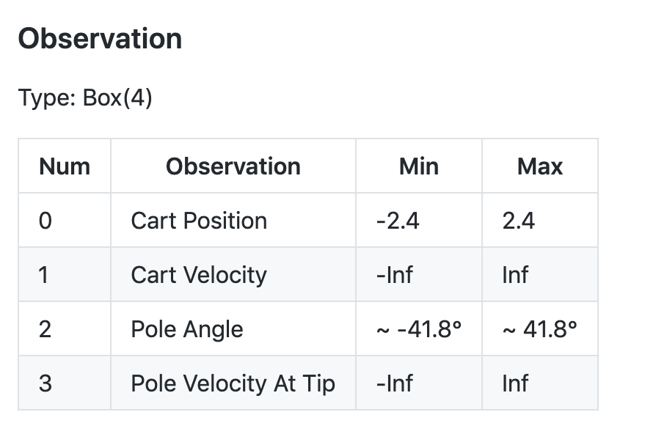
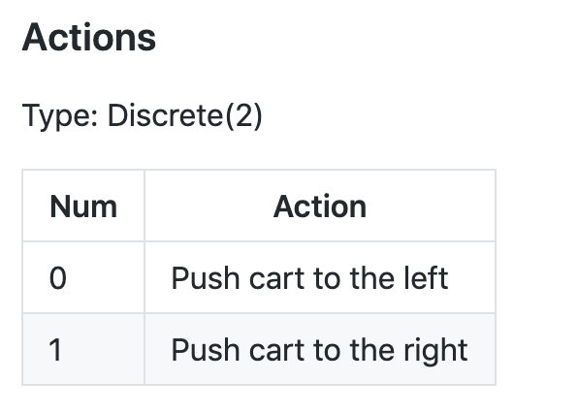
Policy Gradient Descent Example
CartPole with Policy Gradient
Note: The amount the velocity is reduced or increased is not fixed as it depends on the angle the pole is pointing
This is because the center of gravity of the pole increases the amount of energy needed to move the cart underneath it
Let’s do some coding! CartPole

Slide 51
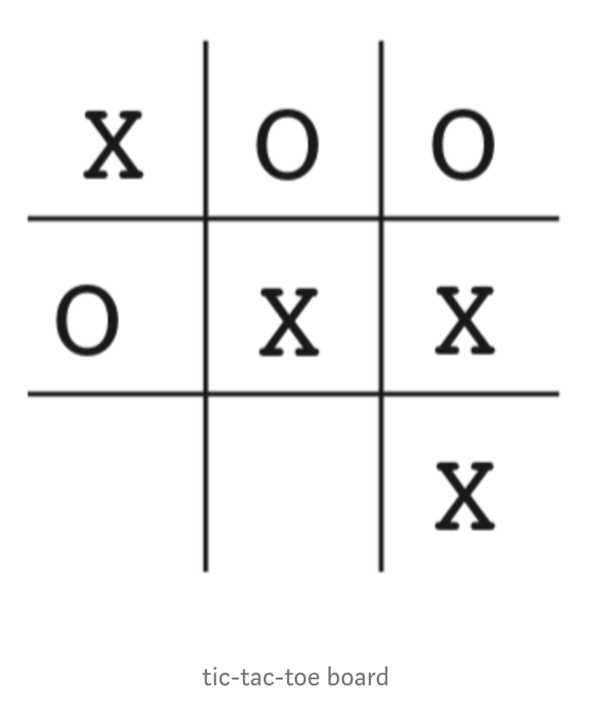
Another Policy Gradient Descent Example
Tic Tac Toe with Policy Gradient Descent Example
We are going to see how to implement a solution for this game exploring different opponents and observe if Gradient Descent does a good job to learn how to play the game
Let’s do some coding! TicTacToe
See you in Lecture 5!

Slide 52
Assignment

Slide 53
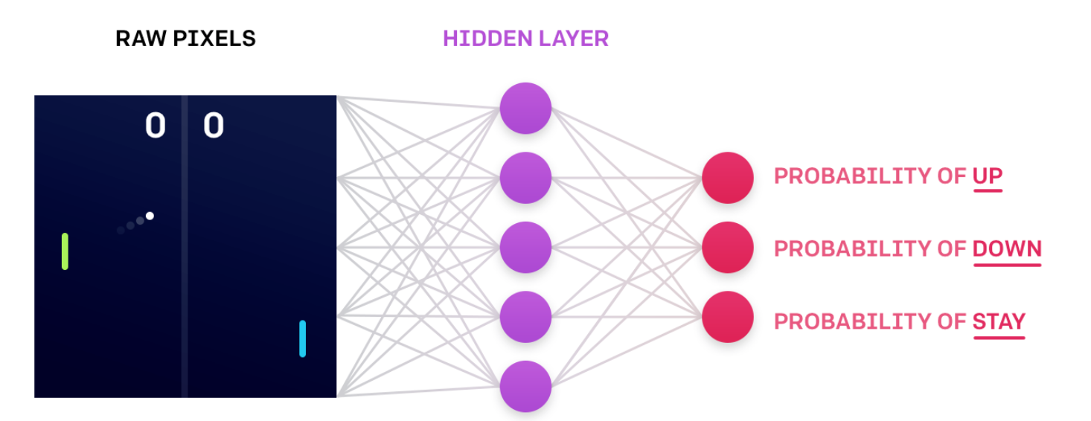
Policy Gradient - Assignment 4
ATARI Pong game
In the last assignment you've approximated the value function. However, there is another way to go: the approximation of the policy. The Policy gradient is a way to implement that
See detailed explanation of problem in the assignment notebook RL_assignment_4.ipynb, located in your student’s Sagemaker environment
A short overview just for those that are not familiar with this game (meaning that you probably haven’t been born when I used to play it!)
PLAY ATARI (warning: it is very noisy !)

Slide 54
References

Slide 55
References

Slide 56
Thank you!!!

